Slide 1
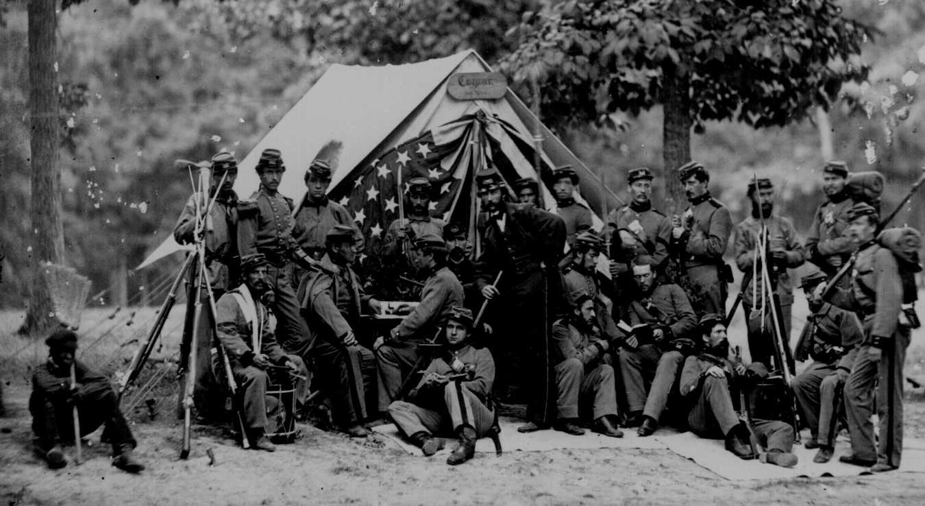
Crisis, Civil War, and Reconstruction
1850-1877

Slide 2
Identifications and Unit Questions- Chapter 3
Describe the growing divide caused by slavery
How were slaveholders views upheld by the federal government during the 1850’s
Analyze and assess the events that led to the Civil War.
Describe the advantages the north enjoyed during the Civil War.
Analyze the impact the Civil War had on the north and the south (economic, political, social)
Describe how Congress and the President differed on Reconstruction
Assess the effect Reconstruction had on the south
Wilmot Proviso
Free Soil Party
Compromise of 1850
Popular Sovereignty
Kansas- Nebraska Act
Bleeding Kansas
Dred Scott v. Sanford
John Brown
Abraham Lincoln
Republican Party
Jefferson Davis
Confederate States of America
Crittenden Compromise
Fort Sumter
Robert E. Lee
Ulysses S. Grant
Emancipation Proclamation
Anaconda Plan
Total War
Reconstruction
13, 14, 15 Amendments
Radical Republican
Du jure segregation

Slide 3
Union in Crisis
The north had developed an industrial economy
The south developed an agricultural economy based on slavery
The issue of slavery and its expansion began to divide the north and south during the first half of the 1800’s
political (where would slavery expand?) and moral (abolition)
To prevent the expansion of slavery David Wilmot proposed Wilmot Proviso
banned slavery in new territory acquired . It never became a law but caused more division between the two regions
Senator John Calhoun preventing the expansion of slavery would violate the Fifth Amendment because it would deny citizens property without due process of law. Since slaves were property it was unconstitutional to deny this expansion

Slide 4
New Political Parties and Compromise
The Wilmot Proviso provided the basis for the formation of the Free Soil Party.
did not support abolition could support the exclusion of slavery in the new territories. ideas
supported by the Northwest Ordinance and the Missouri Compromise.
Martin Van Buren was their presidential candidate in 1848
1850 California applied for admission as a free state.
Compromise of 1850 allowed California to be free but the other new territories would decide the issue of slavery by popular sovereignty (PEOPLE DECIDE TO PERMIT SLAVERY OR NOT). This undid the Missouri Compromise
CA admitted as a free state and other issues that dealt with slavery and territorial acquisition
The Compromise of 1850 also included the Fugitive Slave Act

Slide 5
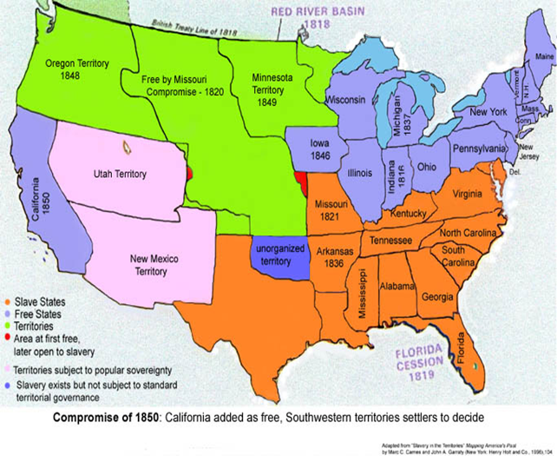

Slide 6
Fugitive Slave Act and Dred Scott Decision
Fugitive Slave Act.
Allowed the arrest of any person that was accused of being a runaway slave, denied a jury trial to fugitive slaves, and required citizens to help capture runaway slaves
Many northerners resented that the federal government forced them to support the slave system
northern states passed personal liberty laws that nullified the Fugitive Slave Act
1857 Supreme Court decision (Dred Scott vs Sanford) led to more division between the north and the south
federal support for the expansion of slavery
Dred Scott was a slave from Missouri that had sued for his freedom and the case was taken to the Supreme Court. His lawyers argued that since he lived in Illinois and Wisconsin, free territory, he should be considered free
court ruled against Scott , said that African Americans were not citizens and Congress did not have the power to ban slavery in the territories because it could deprive citizens of their property

Slide 7
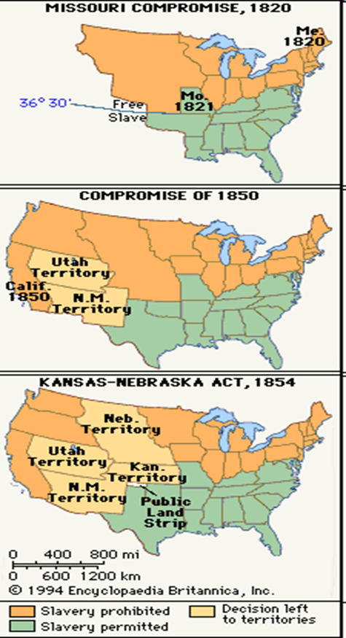
The Kansas- Nebraska Act and “Bleeding Kansas”
Nebraska territory was for the purpose of a transcontinental railroad but it became a proslavery bill
1854 Stephen Douglas, senator from Illinois, introduced a bill to establish this area as a free territory
southern senators objected.
Bill was rewritten Nebraska was free and Kansas was open top popular sovereignty
Many northerners said this was against the Missouri Compromise, that the federal government was supporting slavery
Radical opinion in the north- abolition- became a common view of many northerners
Proslavery and antislavery forces rushed into the new territories and by 1855 two separate governments were established in Kansas

Slide 8
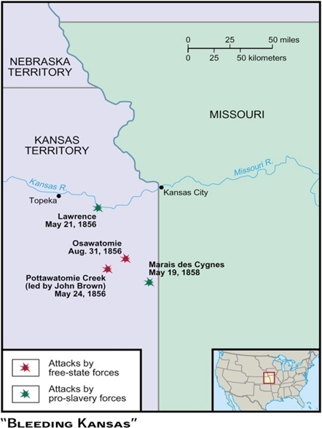
The Kansas- Nebraska Act and “Bleeding Kansas”
1856- Proslavery forces attacked free state town of Lawrence, KS
Two days later in Pottawatomie Creek, KS John Brown a radical abolitionist attacked and murdered five proslavery settlers
Civil war between these forces in Kansas for the next few months. This period became known as “Bleeding Kansas”
In Congress Charles Sumner a senator from Massachusetts was attacked by Congressman Charles Brooks on the senate floor after speaking out against slavery
created a martyr for the north and turned the sentiment of many outside of the south against slavery.
“ how can a barbarous community and a civilized community constitute one state. We must either get rid of slavery, or get rid of freedom” Ralph Waldo Emerson

Slide 10
The Emergence of the Republican Party
Political parties began to split along sectional lines.
Democrats split into southern and northern factions
Whigs wilted under the strain of the Kansas- Nebraska Act
Know Nothing Party emerged to support Americanism
Many smaller parties merged in 1854 and became the Republican party
Republicans included abolitionists, business leaders and northerners opposed to the Fugitive Slave Act and others opposed to the expansion of slavery
quickly became a force and captured 105 seats in the House in the election of 1854.
1856 they nominated Charles Fremont as their presidential candidate won many of the northern states but Democrat James Buchanan was elected president.
Buchanan promised to stop agitation on the issue of slavery. Many Republicans thought Buchanan lacked the backbone to stand up to southerners that dominated the Democratic party

Slide 11
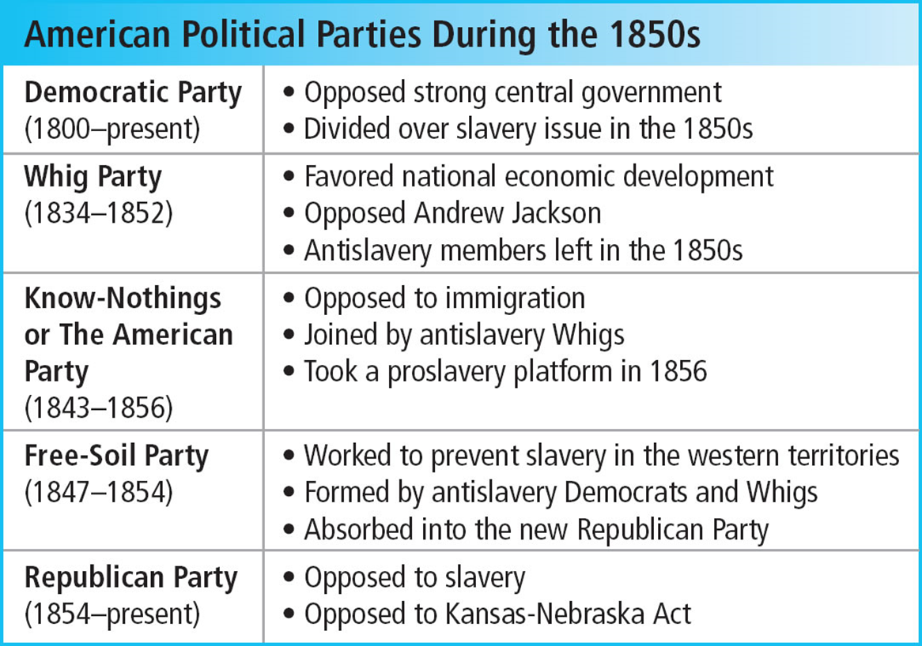

Slide 12
Lincoln- Douglas Debates
Stephen Douglas wanted to be president and he was one of the few Democratic leaders to have the support of both sections of the country
Abraham Lincoln was a former congressman and a small town lawyer. He opposed Douglas for an Illinois Senate race in 1858
Douglas supported popular sovereignty and designed the Kansas- Nebraska Act
The two met for a series of debates . Douglas argued his point for popular sovereignty and Lincoln argued against the expansion, but not the abolition, of slavery
These debates were attended by thousands of people and were the force that led Lincoln to national prominence
Lincoln lost the election to the Senate, but he became a national; figure

Slide 13
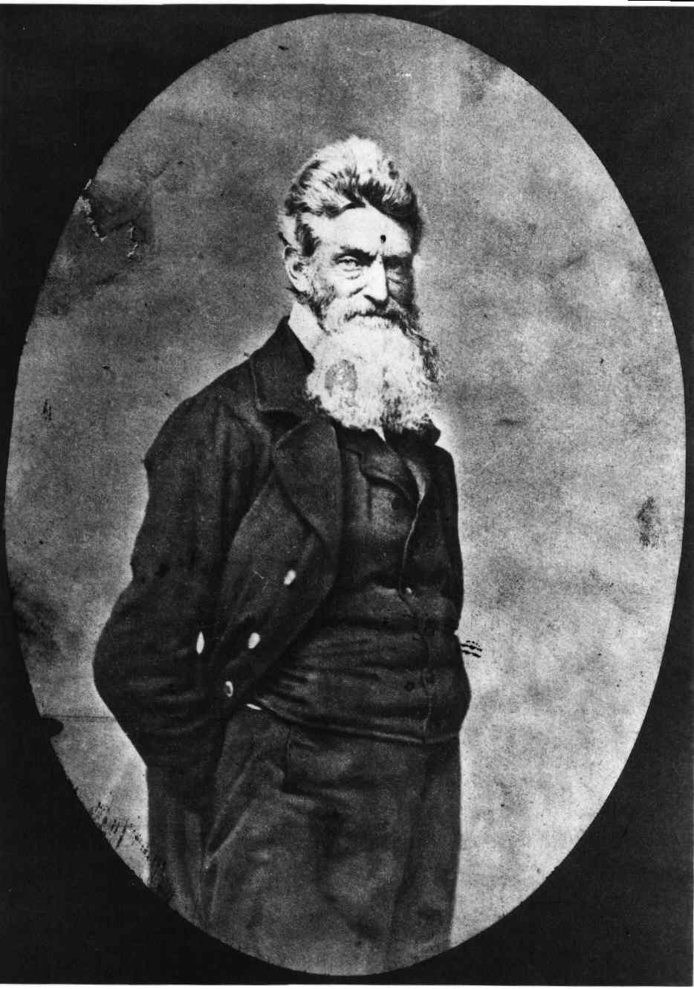
John Brown and the Raid on Harpers Ferry
Radical abolitionist John Brown thought that violence was the best way to defeat slavery
Fall of 1859 Brown and a band of followers attacked the federal arsenal at Harpers Ferry, Virginia hoping to inspire an armed uprising of slaves- none joined
Brown was captured within two days, put on trial and hanged
Brown became a martyr for antislavery, set off panic across the slaveholding south and allowed southerners no reason to distinguish between the abolitionist and Republicans

Slide 14
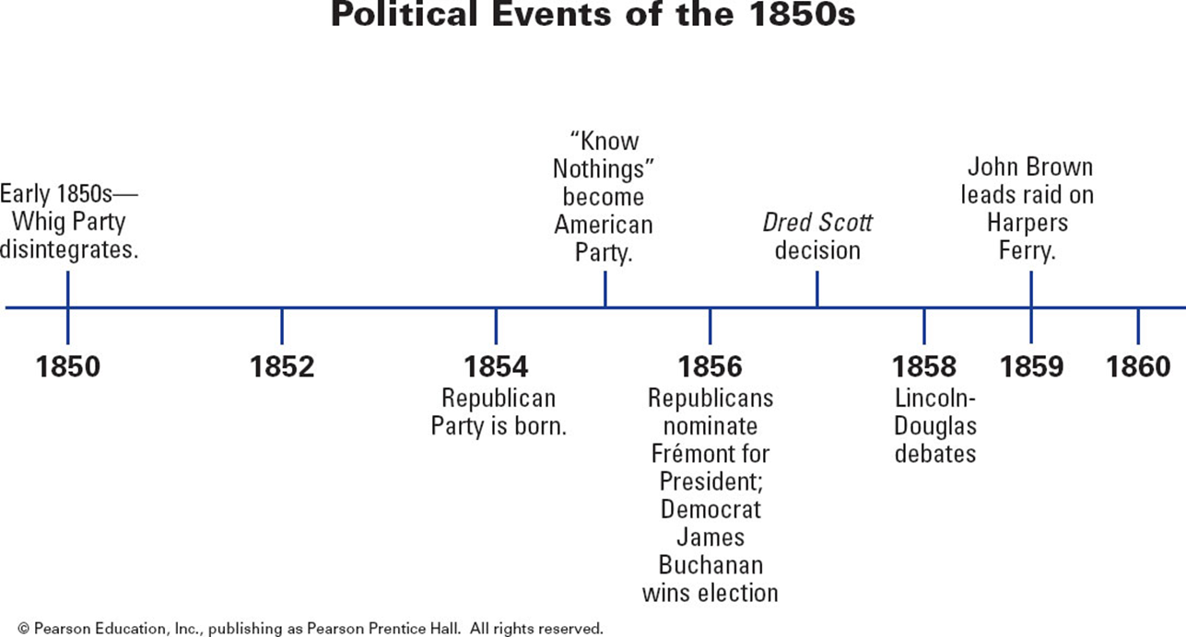

Slide 15
Election of 1860, Secession and War
“ The Greeks did not understand each other any longer, thought they spoke the same language” Thucydides
Americans had many questions on their minds during the election of 1860- the Kansas crisis, Dred Scott decision, expansion of slavery and states rights
Slave holders in the south wondered would radical northerners conspire to eliminate slavery and prevent each state making decisions on its expansion.
Even non- slaveholders in the south felt their way of life was under attack
Would each region of the country accept a president from another region? Could the Union survive?

Slide 16
Democrats Divide, Whigs and Republicans Nominate Candidates
The 1860 Democratic Party argued over slavery and eventually split into two groups- one that was pro- slavery, one that supported popular sovereignty and supported Stephen Douglas
The northern group nominated Douglas
Southern Democrats nominated John Breckenridge who was for expanding slavery into the new territories
Whigs and Know- Nothings created a new party- Constitutional Union Party. Nominated John Bell of Tennessee
Promised to uphold the Constitution and he was against sectional politics
Republicans nominated moderate Abraham Lincoln.
wanted slavery to end and they wanted each state to control their own institutions
against the expansion of slavery but there would be no interference where it already existed.
Lincoln won the election and he did not receive any electoral votes from the south. The election of 1860 demonstrated there were no national political parties, the north and the south were two political entities.

Slide 18
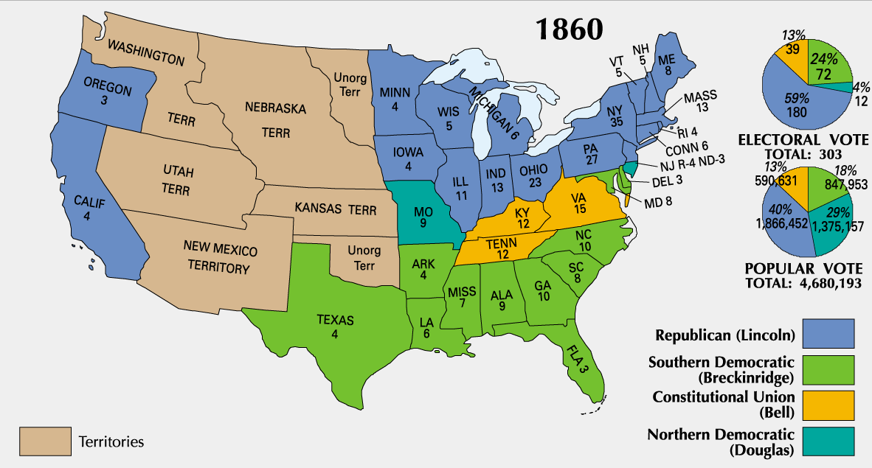
Election of 1860

Slide 19
The Union Collapses
The election of Lincoln convinced the south that they no longer had a voice in national government
December 20 South Carolina voted for secession, over the next few weeks six other states of the deep south left the union.
February 1861 the Confederate States of America are formed with Jefferson Davis as their president.
They adopted a constitution that allowed each state independence and protected slavery.
Not all people in the south supported the Confederacy
Some politicians sought a compromise to solve the issue of slavery. John Crittenden plan would allow slavery south of the Missouri Compromise line and the federal government would reimburse slaveholders for un returned slaves. This was known as the Crittenden Compromise and it was defeated by the senate
President Buchanan did little to stop secession and just waited out the last few months of his term

Slide 21
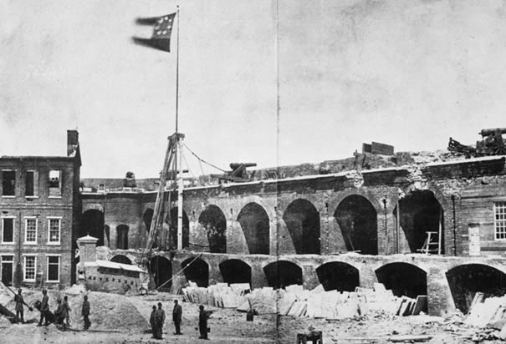
End of the Waiting Game
Lincoln knew he faced a great task when he took office
Inaugural address was conciliatory toward the south He had no intention to interfere with slavery where it existed, but he would preserve the Union. There would be no war unless the south started it
The southern states seized federal forts and arsenals. In South Carolina
April 1861 Fort Sumter, in Charleston, S.C.
April 15 Lincoln asked for 75,000 Union troops to fight against the confederacy
The Confederacy began to raise troops and Arkansas, Tennessee, and North Carolina left the Union
Both sides predicted a short war…..

Slide 22
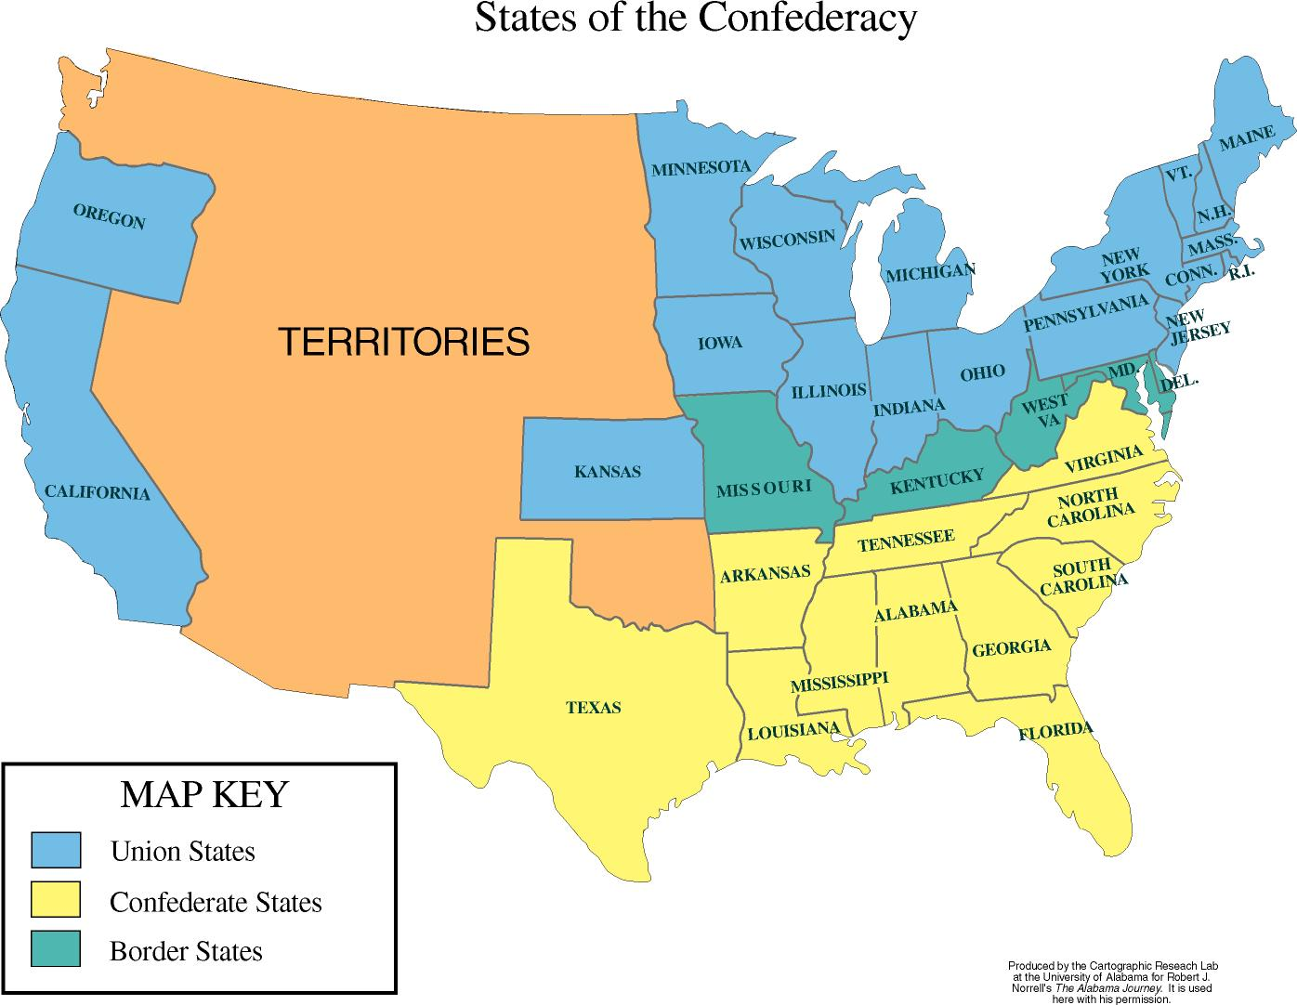

Slide 23
The First Modern War, Advantages and Disadvantages for Both Sides
The Civil War was the first modern war. New technologies and devices mobilized men and materials- railroad transport, artillery, repeating rifles, ironclad ships, telegraph, trenches, wire entanglements were all battlefield devices used for the first time
Advantages for the north: industrial capacity (iron, weapons, textiles, shoes), population (4:1) transportation (more miles of railroad), finance, established government, navy
Advantages for the south: had more experienced military commanders (Robert E. Lee), had a military tradition and a history of expansionism, the southerners were more highly committed to their cause

Slide 24
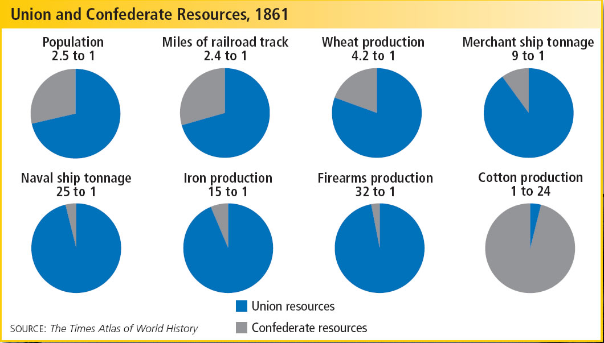

Slide 25
War Strategies
North- Had to conquer the Confederacy on southern soil
South- Had to defend their territory until the north became tired of fighting
Northern generals developed the Anaconda Plan to defeat the south. They wanted to control the coastlines and the Mississippi River and slowly squeeze the south. The southerners could not receive supplies from the outside.

Slide 26
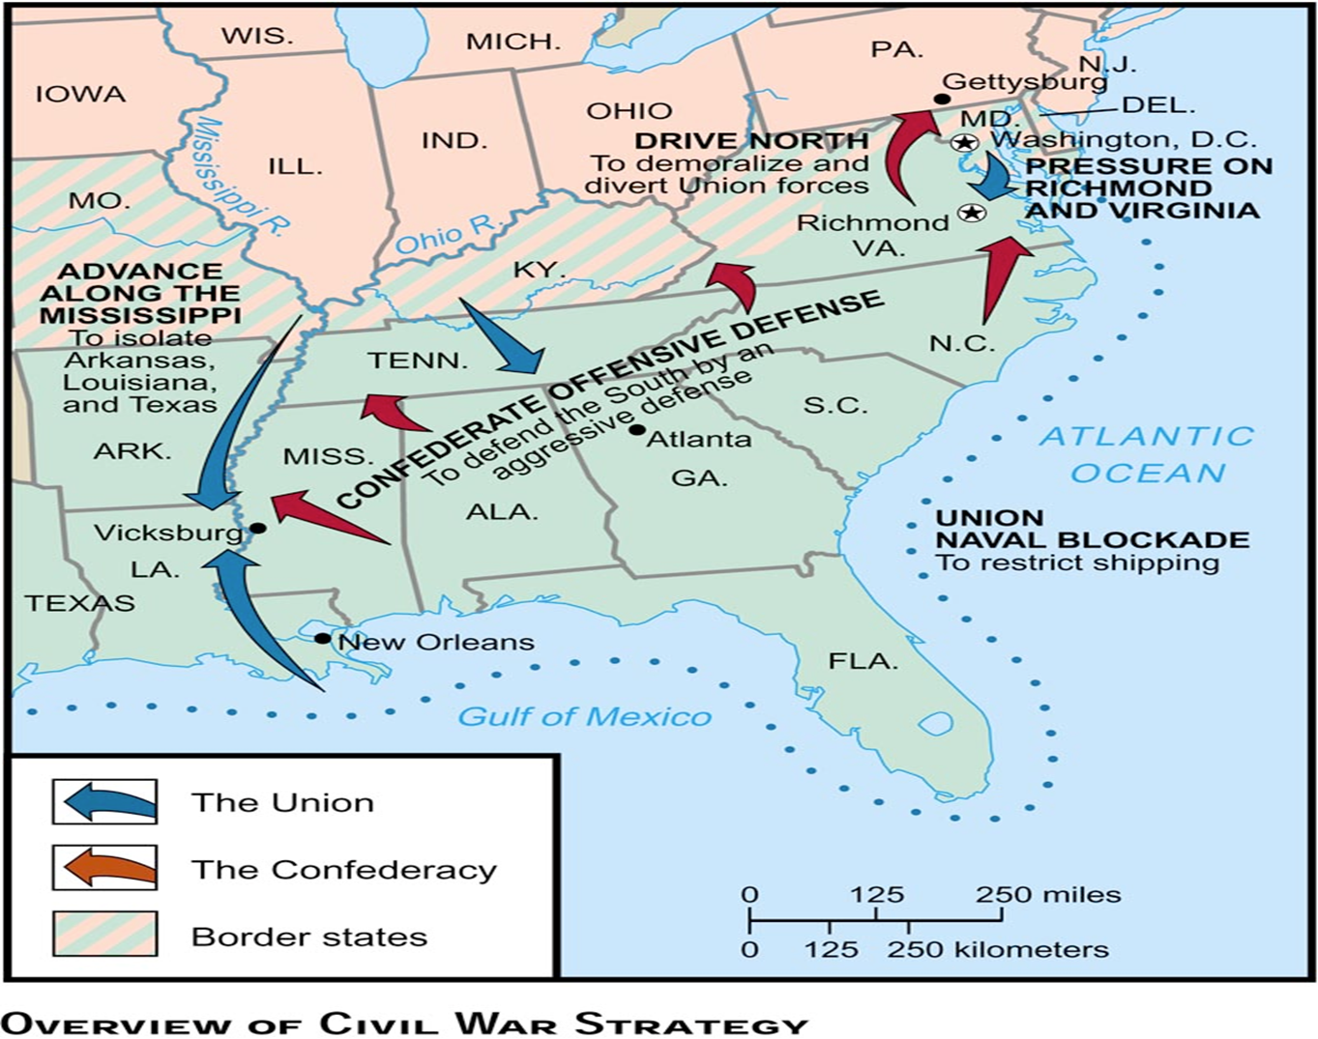

Slide 27
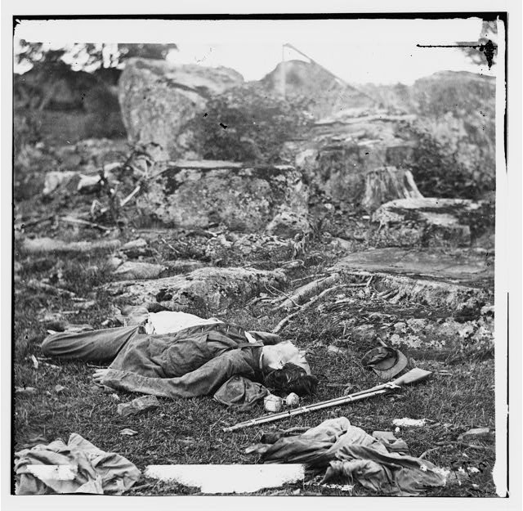
The War
The first battles took place on the east coast, mostly in Virginia. Both sides were trying to capture the other sides capitals ( Washington, D.C. and Richmond, VA)
1861-1863-Nobody could gain an advantage and a stalemate occurred. Many in the north and south wanted peace
Many were shocked by the causalities produced by the new weapons. Photography allowed the images of war to be seen by people far removed from it
Poor medical care ensured that many of the wounded died from infection

Slide 28
