Slide 1
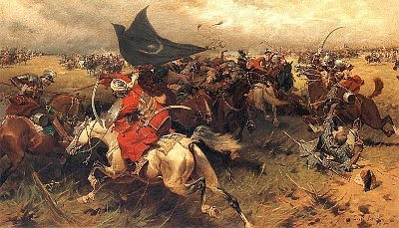
Crusades and the Late Middle Ages

Slide 2
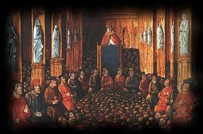
The Crusades
What were they?
From the 11th-13th centuries European Christians carry out a series of wars to regain the Holy Land from the Muslims
How did all of this begin?
Byzantine emperor asks pope for help against the Seljuk Turks
Council of Clermont -Pope Urban II called on feudal lords and kings to take Jerusalem back (1095)

Slide 3
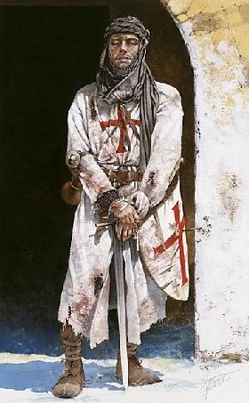
Motives for the Crusades
Pope- way to unite feudal lords against a common enemy.
Crusades could increase the power of the Church
Feudal Lords, Knights- increase wealth and power
religious duty
Merchants- make money with an increase in trade
Port cities ( Genoa and Venice) merchants could make money supplying Crusaders, desire to control trade routes

Slide 4
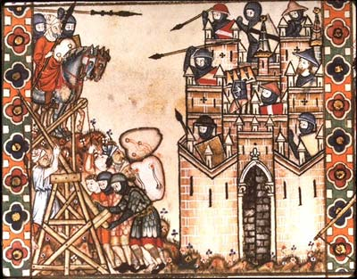
Crusades
Christians captured Jerusalem 1099, massacred Muslim inhabitants
Organized crusader states
1140’s Muslims fight back
1187 Salah al-deen and a Muslim army recapture Jerusalem

Slide 5
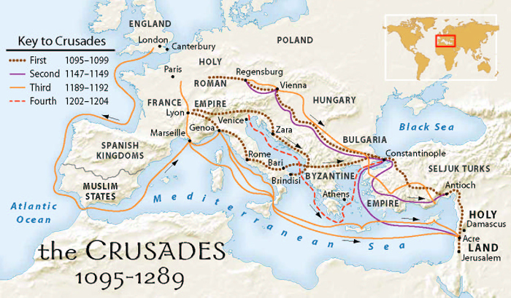
Crusades
1189 Richard the Lionhearted negotiates allowing Christian pilgrims to visit Jerusalem
4th Crusade (1202-1204) merchants from Venice used armies to defeat trade rivals in Constantinople, burned and looted city
1291 Muslims take last Crusader states!!

Slide 6
Effects of the Crusades
European Christians failed to take Holy Land but helped quicken changes taking place in Europe
Increased trade
Europeans wanted products from Asia
Italian cities Genoa and Venice controlled trade routes to the East on the Mediterranean Sea
Crusades encouraged use of money and banking
Peasants sold goods for cash to pay lords
Banks and money first became widely used at this time.

Slide 7
Effects of the Crusades
Increased power of papacy, legacy of mistrust with Muslims
Increased attacks on Jews
Brought Europe to a wider world
Europe was safer place to travel
European traders began to travel to Asia
Helped end feudalism, led to the rise of nation-state
Kings raised taxes to support armies
Nobles sold lands to join Crusades
As nobles lost power kings created stronger centralized governments

Slide 8
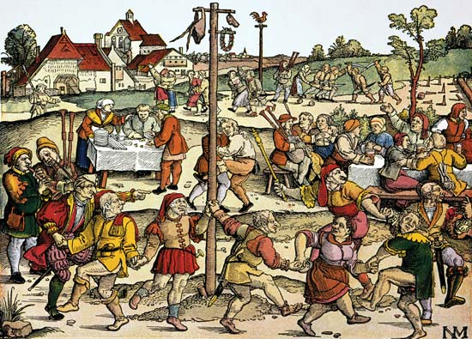
Agriculture, Trade and Cities

Slide 9
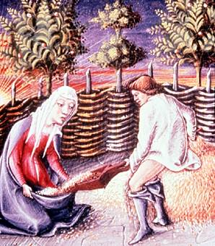
New Agriculture
Between 1000-1300 population in Europe doubled
Why?
Conditions in Europe more peaceful, dramatic increase in food production
Climate Change
Farming technology improved

Slide 10
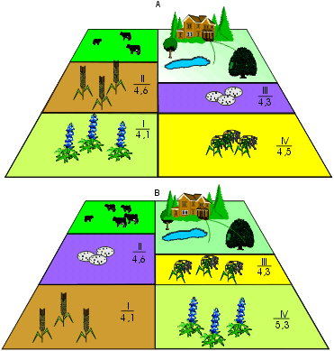
New Agriculture
Changes in Technology
Iron plow made it easier to cultivate more soil
New horse collar gave plows more power
Three field system kept soil healthier, more crops could be grown

Slide 11
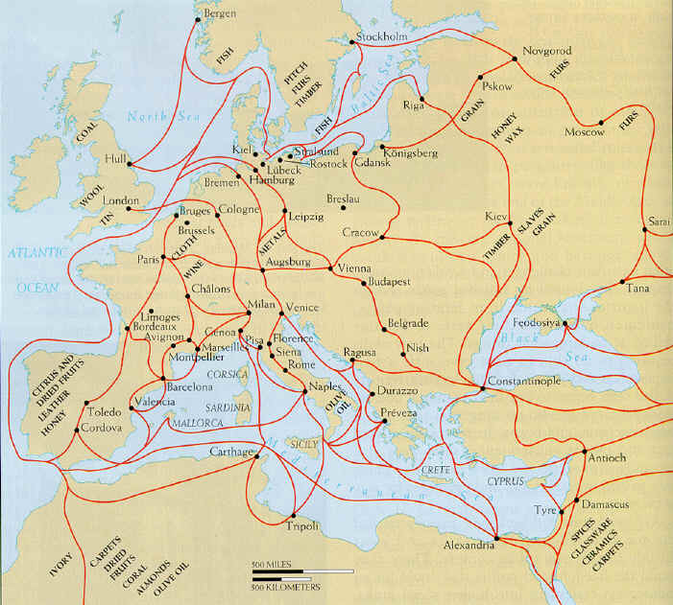
Revival of Trade
11th and 12th centuries trade grew
Cities in Italy took the lead (Venice) close ties with Byzantine Empire, built merchant fleets to carry goods
Flanders in northern Europe center for wool manufacturing
Merchants from all over Europe met there to trade for woolen cloth

Slide 12
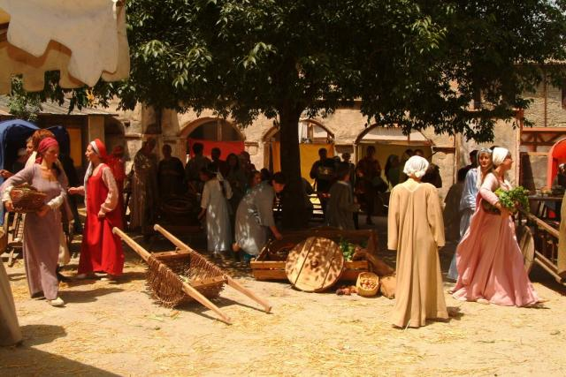
Revival of Trade
As trade increased demand for gold and silver coins increased , rise of money economy
Commercial capitalism- economic system where people invested in goods to make a profit

Slide 13
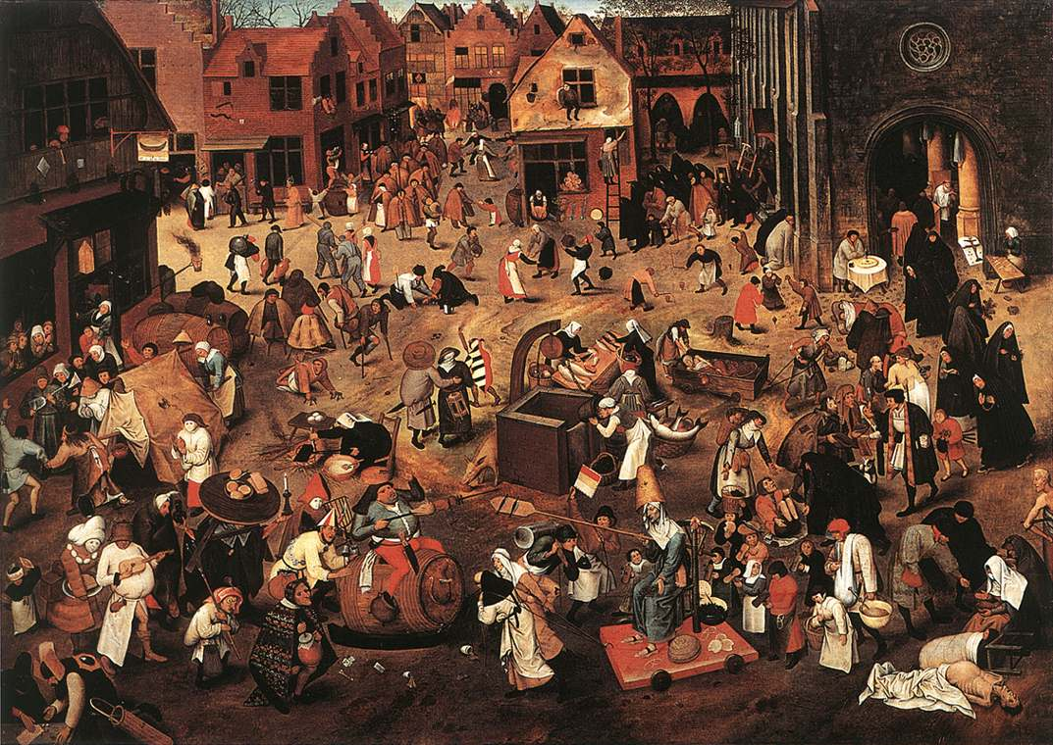
Growth of Cities
Merchants, craftsmen, artisans settled in old Roman cities, near rivers
Ease of trade
Some were located near castles, located near trade routes, offered protection
Medieval cities small – (1200’s London 40, 000, Venice 80,000)

Slide 14
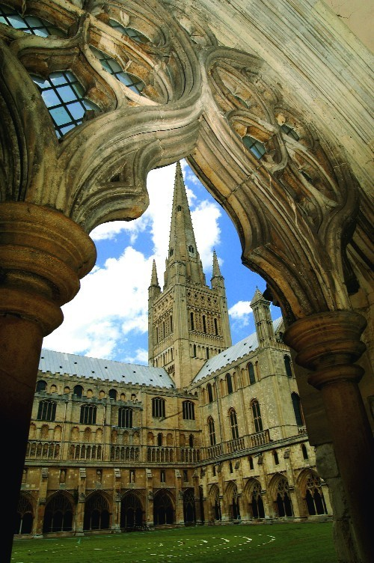
City Government
Town needed freedom of trade and laws to protect trade
By 1100
Lords sold rights to townspeople
Right to buy and sell property
Choose own courts and laws
Over time they began to run their own affairs
Nobility lost more power

Slide 15
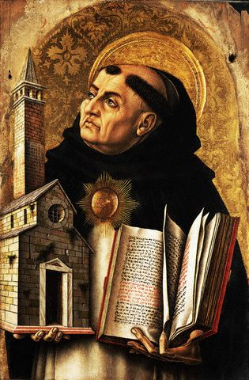
Rise of Universities
Church needed trained clergy, kings needed educated bureaucrats to run day to day affairs
First universities in Europe- Bologna, Paris, Oxford
Philosophical and theological system- scholasticism
New knowledge from Arab translations of Greek work – many questioned how faith and reason could work in harmony
Thomas Aquinas wrote book Summa Theologicia about this subject

Slide 16
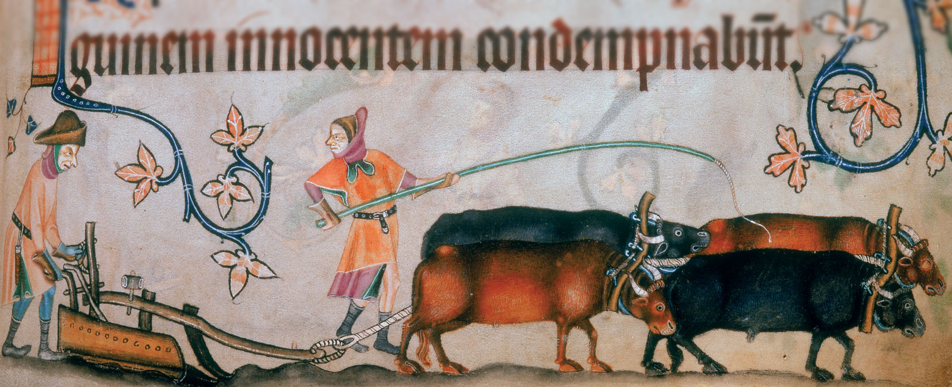
Late Middle Ages
Plague, Decline of the Catholic Church, Hundred Years War

Slide 17
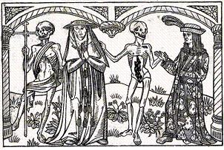
Europe in the 14th Century
Climate change brought crop failure, famine
Plague brought death
People began to question the Catholic Church
Economic decline
Wars and political instability

Slide 18
Black Death
1347 plague begins in Italy
1348 reaches Spain and France
Possibly carried by Mongols from Asia
Spread by rats in crowded cities
At least one-third of European population dies 1347-1351

Slide 19
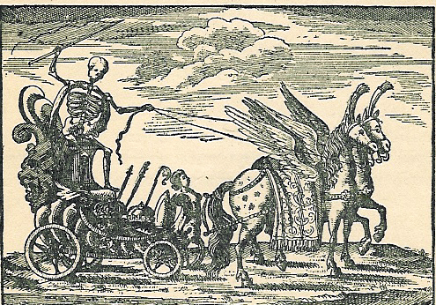
Death Triumphant !: A Major Artistic Theme

Slide 20
A Little Macabre Ditty
“A sickly season,” the merchant said, “The town I left was filled with dead, and everywhere these queer red flies crawled upon the corpses’ eyes, eating them away.” “Fair make you sick,” the merchant said, “They crawled upon the wine and bread. Pale priests with oil and books, bulging eyes and crazy looks, dropping like the flies.”

Slide 21
A Little Macabre Ditty (2)
“I had to laugh,” the merchant said, “The doctors purged, and dosed, and bled; “And proved through solemn disputation “The cause lay in some constellation. “Then they began to die.” “First they sneezed,” the merchant said, “And then they turned the brightest red, Begged for water, then fell back. With bulging eyes and face turned black, they waited for the flies.”

Slide 22
A Little Macabre Ditty (3)
“I came away,” the merchant said, “You can’t do business with the dead. “So I’ve come here to ply my trade. “You’ll find this to be a fine brocade…”
And then he sneezed……….!

Slide 23
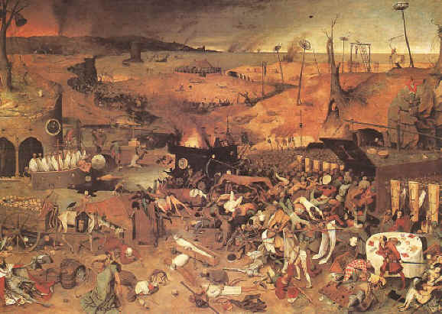
Effects of the Plague
Terrorized people of Europe
Some saw plague as God’s punishment
Did not know what caused it
Jews were blamed and killed

Slide 24
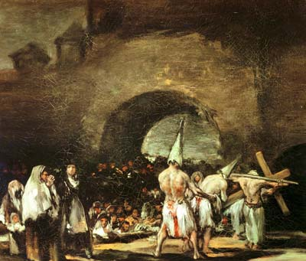
Effects of the plague
Cropland converted to raising sheep because it was cheaper and there were not enough people to work in agriculture
Decline in demand for food led to falling food prices
Shortage of labor, workers wanted higher wages, caused inflation
Merchants pushed for laws to limit wages
Peasants paid cash, not in service

Slide 25
Decline of Church Power
Papacy moved to Avignon, France 1307
1378 reformers elect pope to rule Rome
Time of two popes known as Great Schism
Ended 1417 electing compromise pope
Undermined faith in church, church unable to provide leadership in difficult time
Because of the rise of nation-states European kings were unwilling to accept papal supremacy

Slide 26
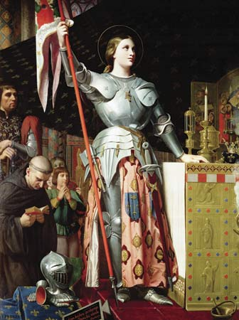
Hundred Years War
England and France at war 1337-1453
England controlled French province of Gascony
French wanted English out of country
English had advantage until 1429
Joan of Arc- God had sent her to fight English- led armies that defeated English and changed war
Joan captured, executed by English
French took control, 1453 last English armies were defeated

Slide 27
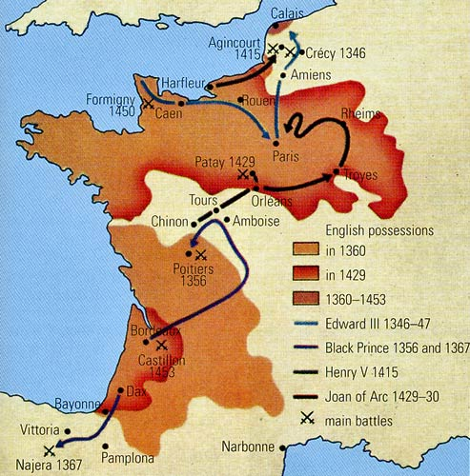
Effects of Hundred Years War
War changed nature of warfare
Use of longbow and cannon caused high death toll
Peasant foot soldiers, not knights became more important in warfare
France
National feeling increased
French kings expand power
England
Kings asked Parliament for money during war
Expanded power of Parliament
Monarchs used hired soldiers to fight, not nobles

Slide 28
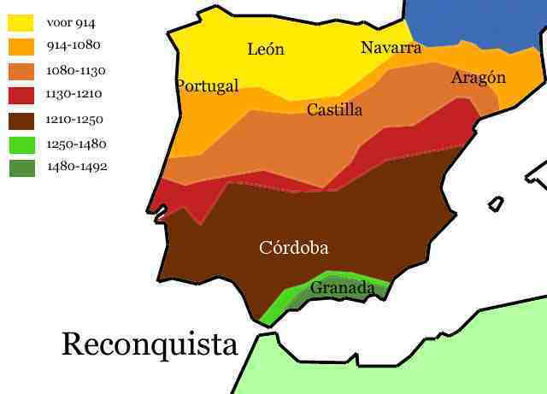
Political Recovery
Old dynasties fell apart
New rulers establish power- France, England, Spain
Reconquista
Middle Ages Christians in Spain fought to remove Muslims
1300 Christians controlled most of Spain

Slide 29
Reconquista
1469 Ferdinand and Isabella king and queen of powerful Spanish kingdoms, marry
1492 Muslims defeated in Granada
Wanted to impose unity on Spanish people
Expelled Jews, Muslims from country
All people had to be Catholic
Inquisition (church court) tried non- Catholics, many were executed

