Slide 1
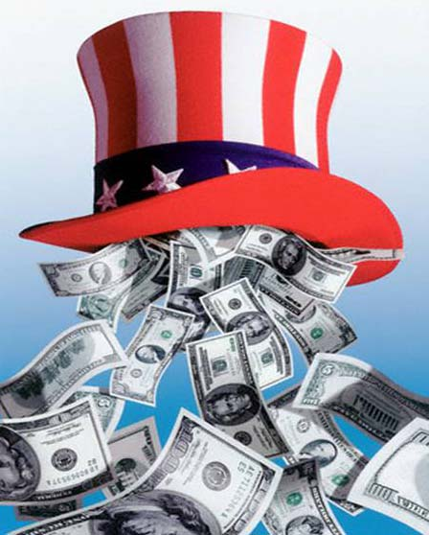
Government and the Economy
Chapter 23

Slide 2
The Role of the Government
Providing Public Goods
Business produce
private goods (goods that when consumed by an individual cannot be consumed by another)
Subject to the exclusion principle (a person is excluded from using a good unless they pay for it)
Government provides goods and services that private businesses do not provide
Governments produce
public goods (can be consumed by more than one person)
Subject to the nonexclusion principle (no person is excluded from the benefits, whether they pay or not)
Difficult to charge for public goods so they are provided by the government
Government raises money to pay for them through taxes

Slide 3
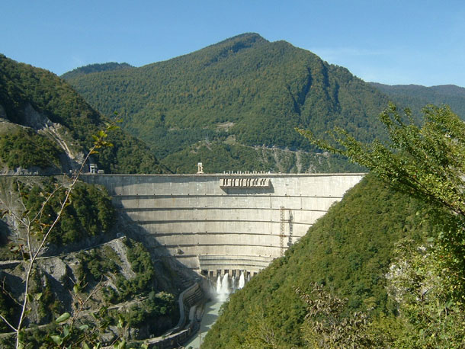
The Role of Government
Externalities
Unintended side effect of an action that affects some one not involved in the action
Government produces public goods to create positive externalities, where everybody benefits (some are direct, some indirect)
Some externalities can be negative (action harms third party)
One role of government is to prevent negative externalities

Slide 4
The Role of Government
Maintaining Competition
Sole provider of a good or service is a monopoly
No competition means they can charge higher prices, take advantage of consumers
Government tries to encourage economic competition through:
Anti-trust laws (laws to control monopoly power)
Sherman Antitrust Act passed in the 1890 banned monopolies and other forms of business that prevented competition
Merger is when two or more business combine to form a single business
If a business merger threatens competition government can step in to prevent it

Slide 5
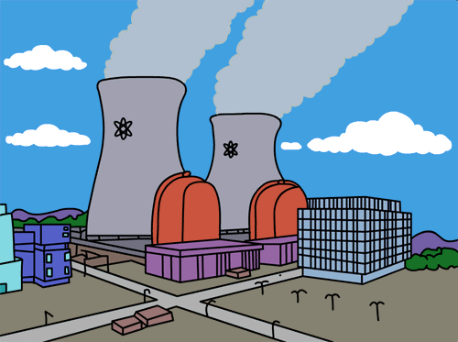
The Role of Government
Regulating market activities
To prevent negative externalities the government regulates business in three important areas
Natural Monopolies
Firms that produce all of a particular good or service for the community called a natural monopoly
Market situation where costs of production are minimized by having a single firm produce the product
Many public services are provided by a single supplier (water, gas, electric)

Slide 6
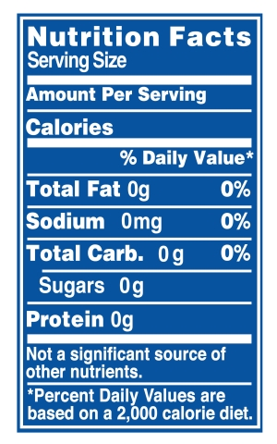
The Role of Government
Advertising and Product Labels
Government involved truth of labeling, product information, and advertising
Federal Trade Commission (FTC), Food and Drug Administration deal with the safety and purity of products
Product Safety
Consumer Product Safety Commission can recall or take products off of market if they are unsafe

Slide 7
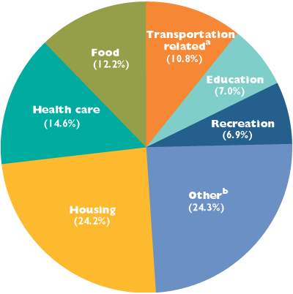
Measuring the Economy
Measuring Growth
Gross Domestic Product (GDP) Dollar value of all goods and services produced in a year
Measure of economic output
Could go up because of price increases
Real GDP is production after price increases have been removed

Slide 8
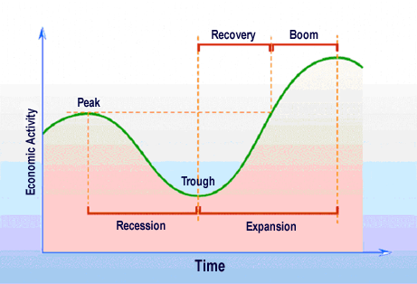
Measuring the Economy
Business Cycle
Economy does not grow at a constant rate, goes through growth and decline
Economic expansion is when the GDP goes up, it reaches a peak and then declines
A recession is when the GDP goes down for six straight months
Expansions are usually longer than recessions

Slide 9
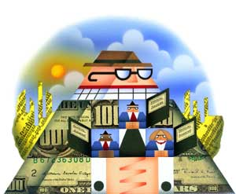
Measuring the Economy
Unemployment
Another measure of economic health is employment
Unemployment rate is percentage of the civilian labor force that are not working but looking for jobs
Civilian labor force includes all civilians 16 or older actively looking for employment or are working
Fiscal Policy
Government policy to help control the economy
Involves government spending and tax policies
Political differences prevent the effective use of fiscal policy to help the economy
Political parties have different ideas about taxes and spending

Slide 10
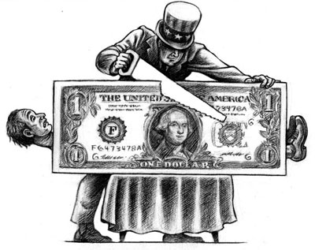
Measuring the Economy
Price Stability
Inflation is the sustained increase of prices over time
Indicator of economic performance
Too much inflation……
Reduces the purchasing power of money
Reduces the value of money saved
Government samples prices every month of 400 commonly used products, known as the consumer price index to find the inflation rate
Government can do very little to control the price of inflation because it results from monetary policy decisions that the government does not make

Slide 11
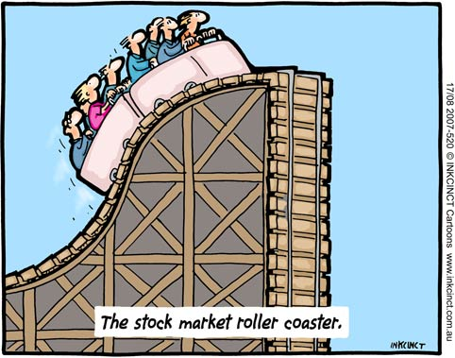
Measuring the Economy
Stocks and Stock Markets
Two ways to make money from stocks
Dividends- share of corporations profits that are distributed to stockholders
Capital gains- when stock is sold for more than it was originally bought for
Price of a stock can change
Sales or profits of a company (raises or lowers price)
Rumor of a possible takeover or news of a technological breakthrough can change demand for companies stock (raises in price)

Slide 12
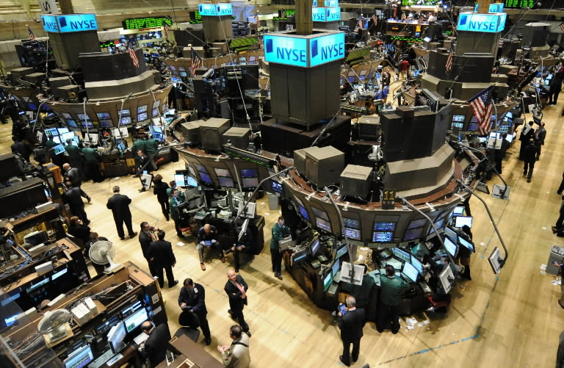
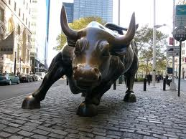
Measuring the Economy
Stocks and Stock Markets
Stock indexes measure stock prices over time
Dow Jones Industrial Average and Standard and Poor’s are the two most popular indexes
DJIA represents 30 popular stocks
Sand P tracks the prices of 500 stocks
Give and idea of the market as a whole
Stocks are publicly traded on the stock exchange
Makes buying and selling easy
Most stocks in the US are traded on the New York Stock Exchange (NYSE), located on Wall Street
These indexes reveal investors expectations about the future
If investors expect growth stocks go up (bull market)
If stock prices fall it is called a bear market

Slide 13
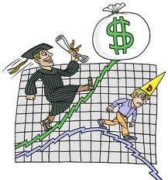
The Government, the Economy and You
Income Inequality
America is a wealthy country but not all Americans are wealthy
Level of education has a major impact on a person’s income
More education=more income
Government tries to encourage people to improve education at all levels
Free lunch programs, low interest college loans are two ways the government encourages education
Having wealthy parents provides access to more educational opportunities and business opportunities

Slide 14
The Government, the Economy and You
Discrimination
Women and minority groups are often not paid as well white men, often passed over for promotions
The government has passed Equal Pay Acts (1963, 2003) and the Fair Pay Act (2008) that require equal pay for equal skills and responsibilities
The 1964 Civil Rights Act bans discrimination on the basis of gender, race, religion and national origin
1990 The Americans with Disabilities Act extended this protection to people with physical and mental handicaps

Slide 15
The Government, the Economy and You
Poverty
People living in poverty receive special attention from the government
The most effective programs have incentives that encourage people to go back to work or improve their employment situation
Most welfare programs are federal programs
Food Stamps, WIC (nutrition and health care assistance to children under 5)
Some welfare programs pay cash to certain people
Supplemental Security Income (SSI) payments to disabled persons 65 and older
Temporary Assistance to Needy Families (TANF) payments to families because parent is deceased, disabled or absent
Number of months that a person can receive assistance is limited, goal is to make sure people look for jobs

Slide 16
The Government, the Economy and You
Workfare Programs
Used to describe welfare recipients to exchange some of their labor in exchange for benefits
Most programs are run at the state level
Designed to teach skills needed to succeed in workforce
Many states require workfare if families receive TANF benefits
Tax policies
Government helps people with progressive tax policies
Taxed at a lower rate for lower incomes and higher rates for higher incomes
Earned Income tax credit gives tax credits and cash payments to qualified workers

