Slide 2
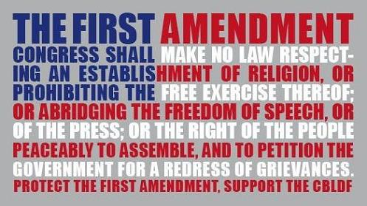
The Bill of Rights

Slide 3
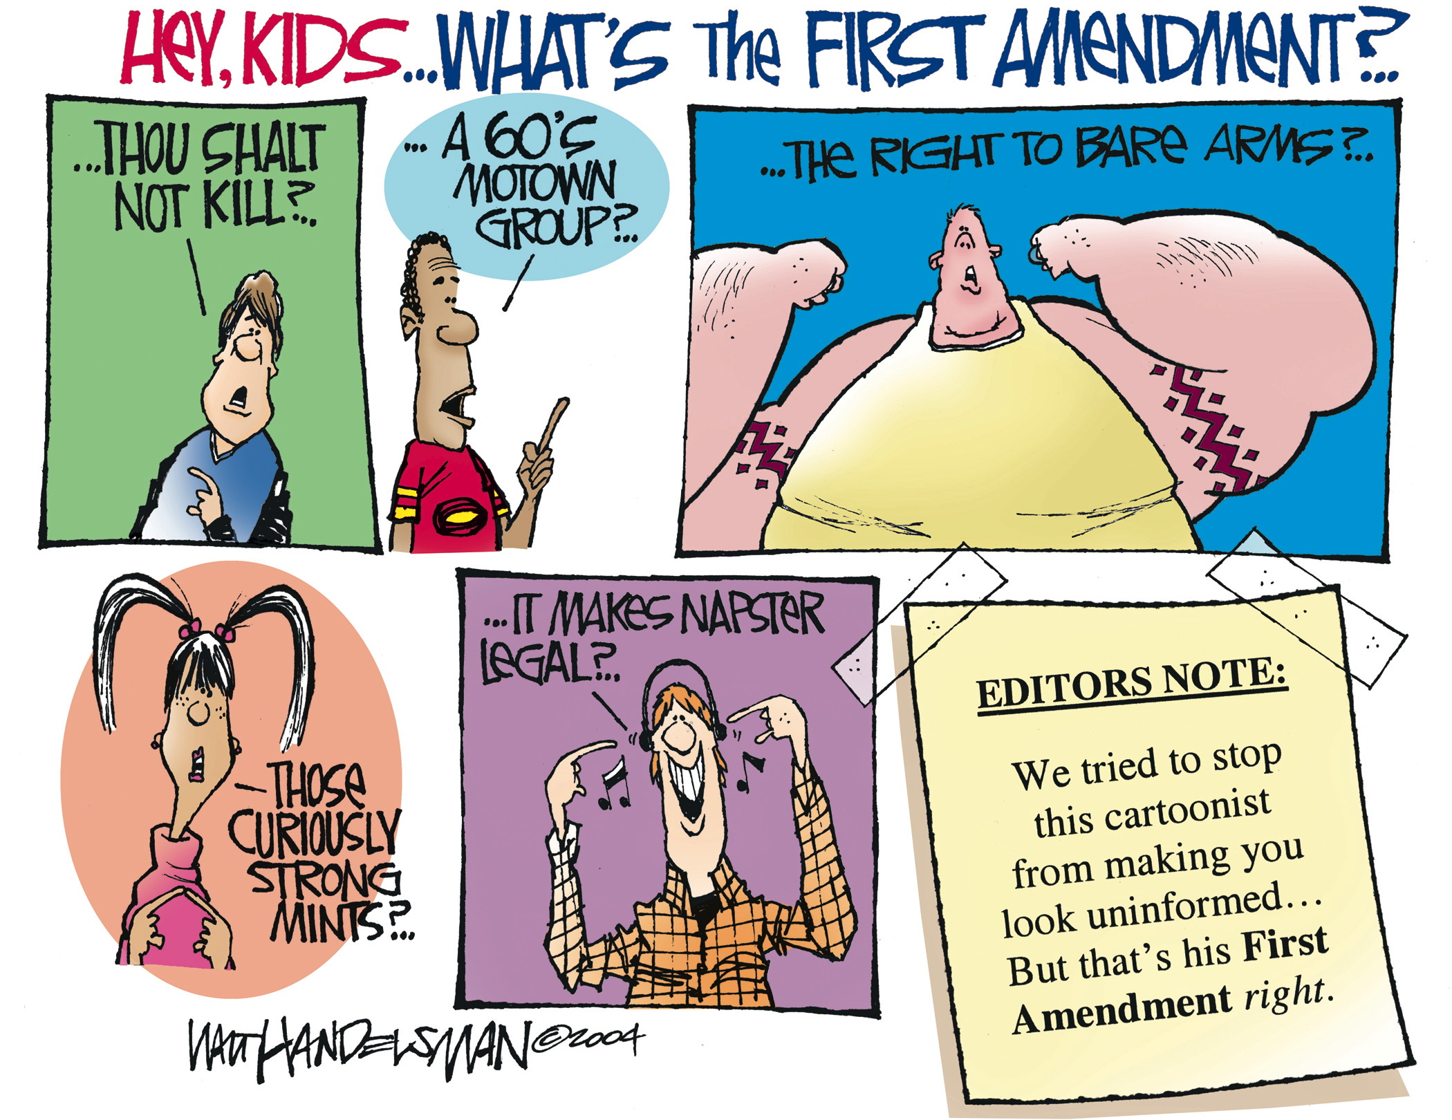

Slide 4
First Amendment Freedoms
Founders of US believed in protecting individual rights, providing for safety and well being of citizens
Bill of Rights places limits on powers of government.
Protects civil liberties
Five basic freedoms protected in 1st Amendment: speech, religion, assembly, press and to petition the government

Slide 5
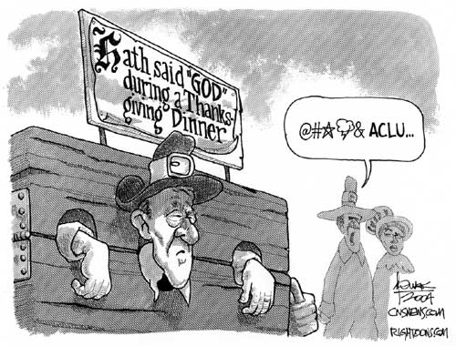
First Amendment Freedoms
Freedom of Religion
The U.S. has freedom of religion, first colonists came to the U.S. to escape religious persecution
Prohibits gov’t from establishing official religion in US
Freedom of Religion allows Americans to practice any faith

Slide 6
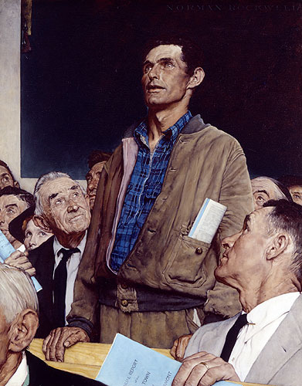
First Amendment Freedoms
Freedom of Speech
First amendment guarantees that we can say whatever we want without gov’t persecution
Internet communication, art, music clothing interpreted by Supreme Court as speech
1969: Tinker vs. Des Moines Independent Community School District, 1965
Supreme Court declared armbands a form of speech
Allowed students to protest the Vietnam War by wearing black armbands

Slide 7
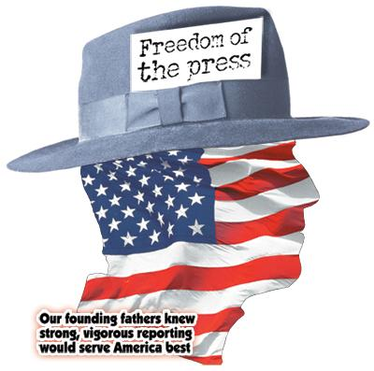
First Amendment Freedoms
Freedom of the Press
Freedom of the press
allows books, newspapers,
magazines, radio, TV, and
computer networks to print
and broadcast anything
without fear of censorship by
the government
This allows the U.S. to have a wide variety of beliefs and ideas

Slide 8
First Amendment Freedoms
Freedom of Assembly
Right to gather in groups for any reason as long as the assemblies are peaceful
Right to form and join social clubs, political parties, labor unions, and other organizations
Freedom to Petition
Right to express your ideas to the government
Do they always respond?

Slide 9
Limits on the First Amendment
Security Comes First
Supreme Court has decided safety and security of Americans justify limitations
The 1st Amendment never intended to allow Americans to do whatever they please, the nation and its communities come before the rights of the individual
You can criticize government officials but you can’t spread lies that harm that person’s reputation
Slander is spoken and libel is printed
You do not have freedom to
provoke a riot or violent behavior
speak or write in a way that leads to criminal activities
overthrow government
cannot interfere with the rights of others

Slide 10
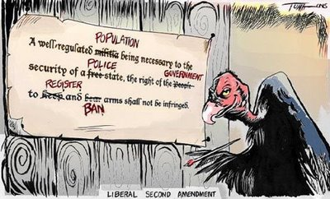
Other Guarantees in the Bill of Rights
Second Amendment
Gives us the right to “bear arms”
Debate over what it means;
Some argue its only for states to maintain “a well regulated militia” allowing the members to carry arms
Others say it guarantees the right for all citizens to “keep and bear arms” without gov’t interference
Courts have ruled that the gov’t can pass laws to control but not prevent firearm possession

Slide 11
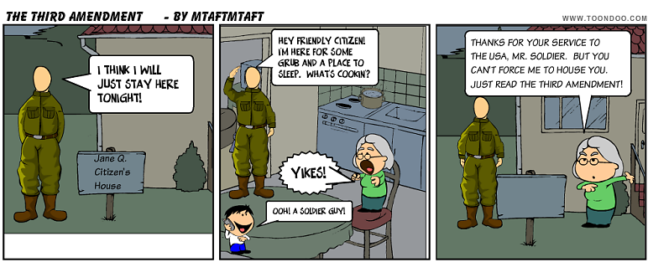
Other Guarantees in the Bill of Rights
Third Amendment
Housing and feeding troops was one cause of American Revolution
Says that in peacetime, soldiers may not be housed in private homes without consent of the homeowner
During war, it must be authorized by government

Slide 12
Other Guarantees in the Bill of Rights
Bill of Rights protects our civil liberties
These are the freedom we have to think and act without government interference
Protecting the Rights of the Accused
4th, 5th and 6th Amendments protect the right to fair legal treatment
The Fourth Amendment
Protects against unreasonable searches and seizure, gov’t and police cannot search your home or take your property without good cause
Police can ask a judge to issue a search warrant if they believe that you have committed a crime which gives them the right to search your property

Slide 13
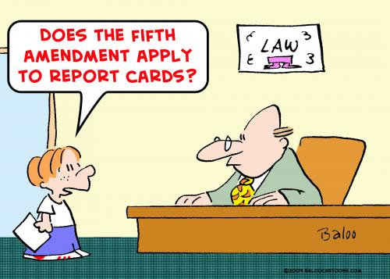
Other Guarantees in the Bill of Rights
The Fifth Amendment
Protects rights of the accused
Cannot be put on trial for serious federal crime without and indictment from a grand jury
Protects people from double jeopardy, accused of a crime and found not guilty may not be put on trial again for the same crime

Slide 14
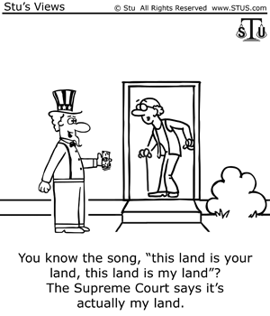
Other Guarantees in the Bill of Rights
Protects accused person’s right to remain silent, against self-incrimination, (testifying against yourself)
May not be denied life, liberty, or property without due process of law (following legal procedures)
Protects citizens’ property rights by limiting the gov’ts power of eminent domain: (right of the gov’t to take private property for public use)

Slide 15
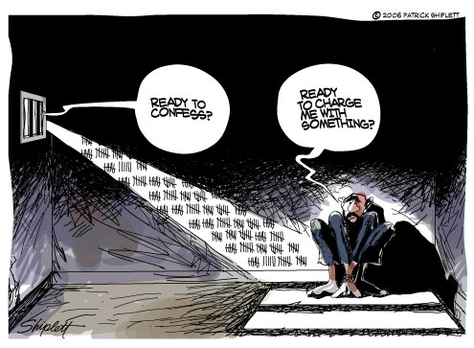
Other Guarantees in the Bill of Rights
The Sixth Amendment
Gives due process to people accused
of crimes, it requires that:
Person must be told of the charges
It guarantees them trial by jury
A speedy and public trial,
Right to hear and question witnesses, call witnesses in their defense
Have an attorney even if they cannot afford one
Gideon v Wainwright (1963)
Supreme Court ruled after amendment written that the gov’t must pay for attorney

Slide 16
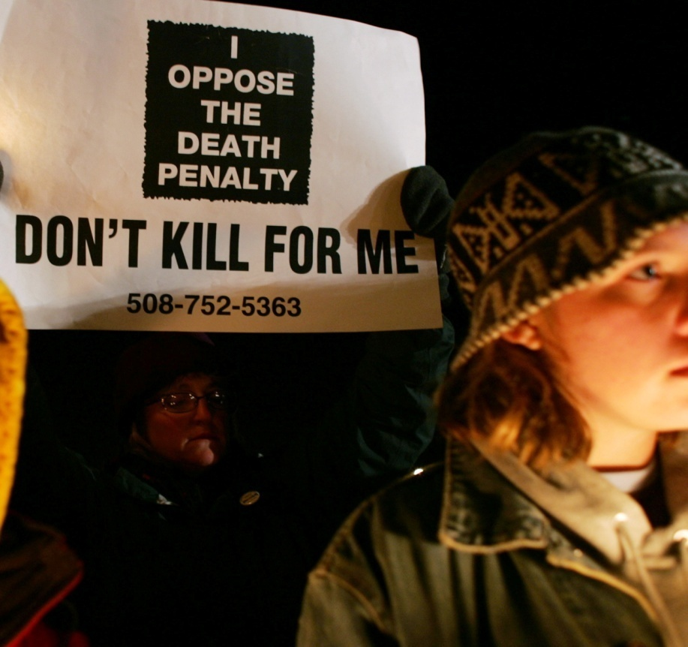
Other Guarantees in the Bill of Rights
The Eighth Amendment
prohibits excessive bail
Bail- sum of money used as a deposit before a trial in order to get out of prison
If the accused appears for court then bail is returned, if not it is forfeited
Forbids excessive fines for people convicted of crimes and cruel and unusual punishment

Slide 17
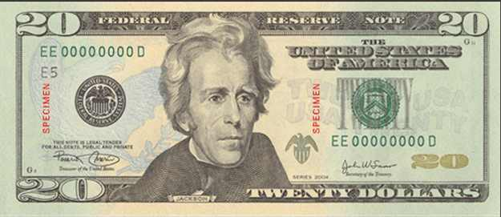
Other Guarantees in the Bill of Rights
Seventh Amendment
Concerns civil cases (disagreements between individuals)
Right to jury trial in cases that involve more than $20
Does not require jury trial
Judge can decide case

Slide 18
Other Guarantees in the Bill of Rights
Ninth Amendment
Says that citizens have other rights beyond those listed in the Constitution, protects our right to privacy
Protects freedom from gov’t interference in our personal affairs

Slide 19
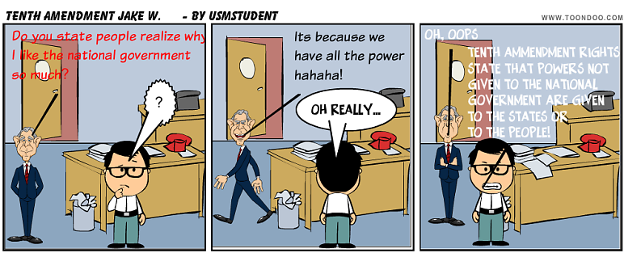
Other Guarantees in the Bill of Rights
Tenth Amendment
Any powers not specifically given to the national gov’t are reserved to the states or the people
Education, marriage, and slavery
Prevents federal government from becoming too strong

Slide 20
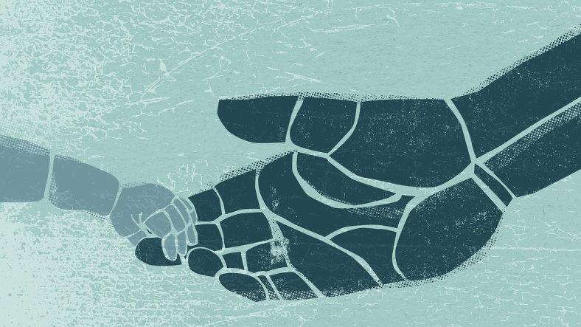
Extending the Bill of Rights
For many years after the passage of the Bill of Rights, state and local governments were not bound by its terms and states passed laws that violated civil liberties
The 13th, 14th, 15th, Amendments known as the Civil War Amendments made states responsible for protecting civil liberties
Other amendments were also responsible for extending the Bill of Rights to other citizens and giving more citizens a say in government through voting

Slide 21
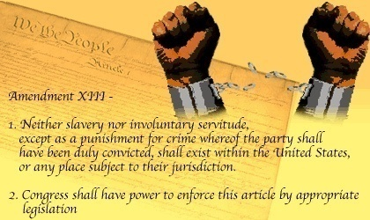
Extending the Bill of Rights
13th: officially outlawed slavery in the United States and this freed thousands of African Americans
Outlawed forced labor except as punishment
Still did not effectively guarantee full rights for African Americans

Slide 22
Extending the Bill of Rights
14TH Amendment (1868)
Passed to prevent southern states from keeping African Americans from holding jobs, denying them property , and other restrictions
Every state must grant its citizens “equal protection of the laws”
Over time it was used to help other groups that weren’t treated equally (women, people with disabilities, etc.)
Defines a U.S. citizen as anyone “born or naturalized in the U.S.”
Forbid state government from unreasonable action or interference with citizens
Made the idea of “due process” apply to the states

Slide 23
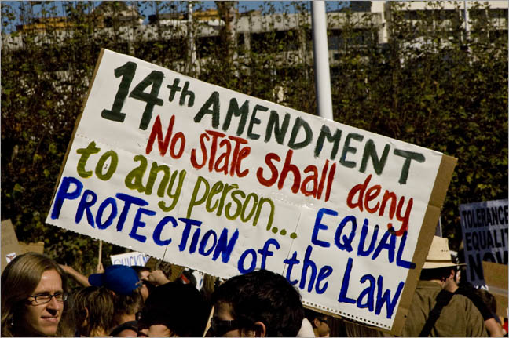
Extending the Bill of Rights
When written the Bill of Rights only applied to the federal government not states
1925 Supreme Court ruled in Gitlow v. New York that the 14th Amendment applied to free speech and free press from state laws
After this case Supreme Court interpreted that all of the Bill of Rights applied to the states and federal government
14th Amendment made the Bill of Rights binding for state AND national government (nationalization of Bill of Rights)

Slide 24
Extending the Bill of Rights
15th Amendment (1870)
Says that no state may take away a person’s voting rights on the basis of race, color, or previous enslavement
This amendment was aimed to give suffrage (the right to vote) to African Americans but southern states still found ways around it
Did not apply to women

Slide 25
Extending the Bill of Rights
17th Amendment (1913)
Allows voters to elect their senators directly instead of the previous system where state legislatures had elected them
19th Amendment (1920)
Gave women the right to vote in all national and state elections
Both of these amendments gave people greater voice in government

Slide 26
Extending the Bill of Rights
The 23rd Amendment (1961)
Allows the residents of Washington D.C. to vote for president and vice president
The 24th Amendment (1964)
Made poll taxes illegal in national and state elections; this prevented states from keeping poor citizens from voting
The 26th Amendment (1971)
Sets the voting age at 18 (it was 21), this was done while America was involved in the Vietnam Conflict
Allowed teens who were fighting for the army to be able to vote

Slide 27
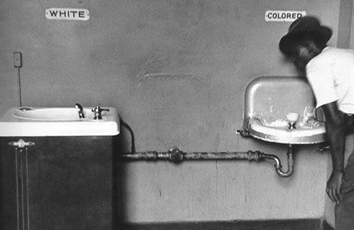
The Civil Rights Struggle
Even thought the Civil War Amendments were supposed to protect them….
Post Civil War, African Americans faced discrimination
Discrimination – unfair treatment based on prejudice against a certain group
South had “Jim Crow” laws
Separation in pubic places
Segregation
Legal separation of the races
Civil Rights were needed
The rights of full citizenship and equality under the law

Slide 28
The Civil Rights Struggle
African Americans seen as “second-class citizens”
National Association for the Advancement of Colored People (NAACP) established in 1909 by African Americans and whites
Worked through courts to challenge laws and customs
1910 the National Urban League founded
To aid in finding jobs and getting ahead in life
1940s-1960s Civil Rights Movement gradually developed from these and other groups
Formed to fight unfair discrimination
Millions supported the movement

Slide 29
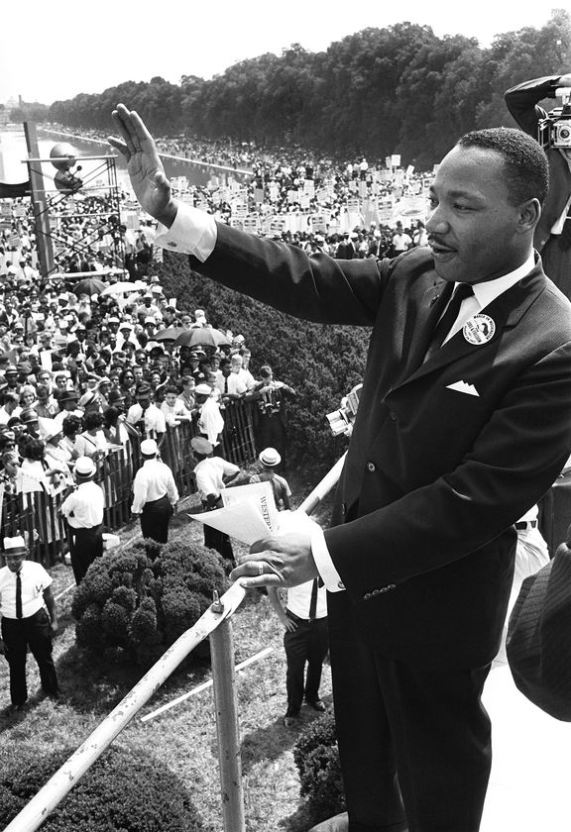
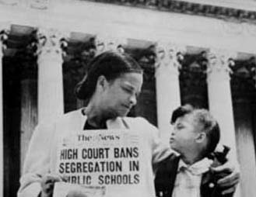
The Civil Rights Struggle
1948 – President Truman ordered the end to segregation in armed forces
1954 – Brown v. Board of Education of Topeka, Kansas
Argued segregated public schools unconstitutional
Segregation violated 14th Amendment principle of equal protection under the law
1950s – Dr. Martin Luther King, Jr. became one of the main leaders of the civil rights movement.
Baptist minister, great orator
Believed in nonviolent resistance
Helped organize marches, boycotts, and demonstrations

Slide 30
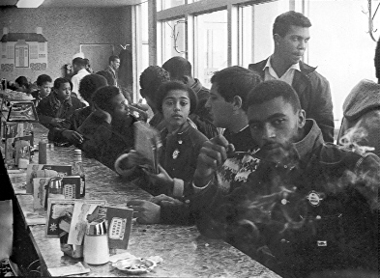
The Civil Rights Struggle
1960 Sit-in movement begins in Greensboro, NC
Spreads across the south and it becomes an effective mass movement.
April 1960 Southern Black students formed the Student Non-Violent coordinating Committee (SNCC)
Organized voter registration drives across the south
Often at odds with NAACP and MLK because they wanted more immediate change

Slide 31
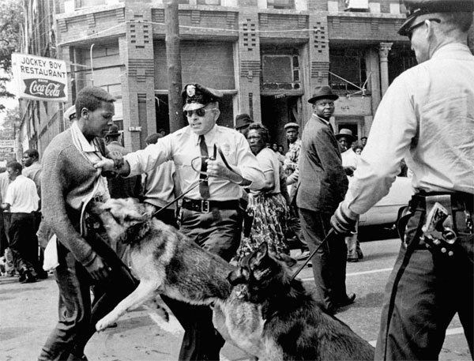
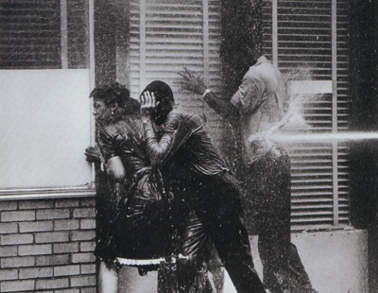
The Civil Right Struggle
Spring 1963 King begins a campaign against discrimination in Birmingham, AL
Police reaction
Attacked protesters with dogs and fire hoses
Shocked many Americans because it was seen on TVs across the country
Turned the tide in support of civil rights for African Americans
June 11, 1963 President Kennedy responds.
Calls for new Civil Rights legislation
Calls problem a moral issue

Slide 32
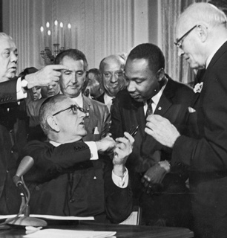
The Civil Rights Struggle
1960s
“Freedom Riders”
Freedom Riders tried to end segregation in facilities serving bus passengers
After violent incidents federal marshals were sent to protect Freedom Riders
Civil Rights Act of 1964
Passed by Congress
Prohibited discrimination in public facilities, employment, education, voter registration.
Banned discrimination by race, color, gender, religion, and national origin

Slide 33
The Civil Rights Struggle
1964 voting rights becomes the main goal of civil rights movement.
Passage of 24th Amendment
outlawed poll taxes
Freedom Summer of 1964 was a massive voter registration drive in Mississippi
Three civil rights workers were murdered
MLK resumed voter registration drive in AL, “March to Selma”
Voting Rights Act of 1965.
Did away with literacy requirements to vote
Johnson sends in federal officials to oversee voter registration.
Over the next 25 years totally transforms the south because blacks are voting.

Slide 34
The Civil Rights Struggle
Many gains since the 1960s civil rights movement for all minorities
1970s – affirmative action programs
Encouraged the hiring and promoting of minorities and women in fields that were traditionally closed to them.
Colleges also practiced this.
Affirmative Action controversial from the beginning
Some saw it as reverse discrimination
People still face workplace discrimination, racial profiling, hate crimes

