Slide 2
New Government
Continental Congress had to define powers of central
government
States had following features in common
Basic bill of rights
Separation of Powers
Voting for property owning, white males
National Government
Articles of Confederation- adopted 1777
Purposely weak central government
Unicameral legislature
Congress could make war, borrow money, make treaties
Could not collect taxes or regulate commerce

Slide 3
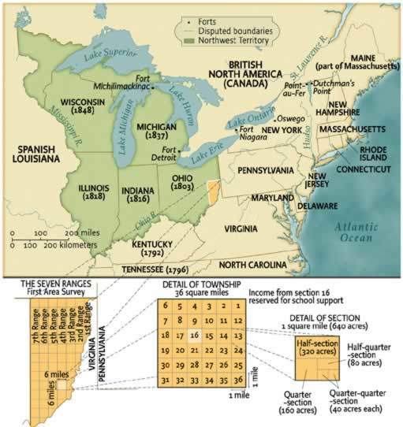
New Government
Accomplishments of the Articles
Won the war
Land Ordinance 1785, Northwest Ordinance of 1787
Provided a method of dividing up new territory and how to extend the political system

Slide 4
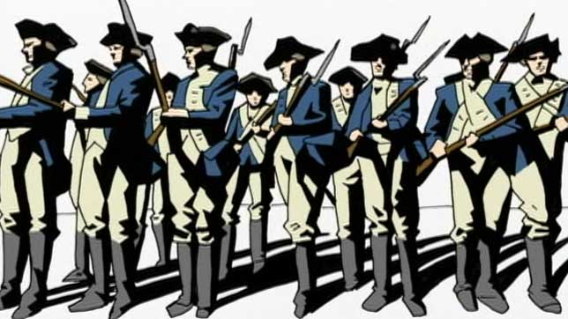
New Government
Problems
Could not deal with financial issues
money worthless, could not collect taxes, debt with European countries
Foreign issues- European countries had little respect for U.S. a nation
Domestic- Shay’s rebellion

Slide 5
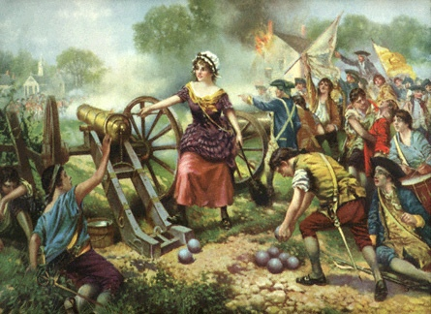
Social Changes
No more aristocracy
Separation of church and state
Women helped with war, but remained second-class citizens
Slavery- opposing ideas of liberty and slavery

Slide 6
Social and Political Changes from the Revolution
Changes in social customs, political institutions, ideas about society, government and gender
Revolution and Loyalist exodus left new class in charge (patriot elite)
After Revolution, most states reduced property qualifications for voting
By 1800 indentured servitude unknown
Growth of trade organizations, removal of inheritance laws (primogeniture)
The fight for separation of church and state (Virginia Statute of Religious Freedom (1786)

Slide 7
Social and Political Changes from the Revolution
Challenges to institution of slavery
Quakers establish first anti-slavery society
Many northern states call for gradual emancipation or abolition
Southern states keep slavery
Laws discriminated against free blacks and slaves (jobs, education, marriage)
Idealism of freedom sacrificed for political expediency, fight would fracture national unity

Slide 8
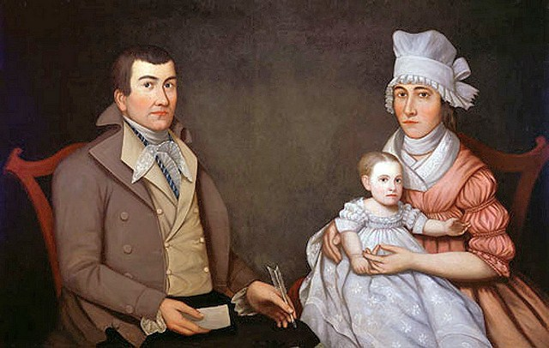
Social and Political Changes from the Revolution
Women still were unequal to men
developed idea of “republican motherhood” , elevated women to higher status, keepers of the nation’s conscience
Women raised the children, held the future of the republic in their hands

Slide 9
Social and Political Changes from the Revolution
1776- Continental Congress called upon states to draft constitutions, form governments
Sovereignty would come from people, contracts defined powers of government
States had written documents that represented a fundamental law.
Many had a bill of rights, required annual election of legislators.
All of them deliberately created weak executive and judicial branches, distrust of central power
In most states, the legislative branch given sweeping powers

Slide 10
Economic Issues
After war there was a lot of available land
Inflation was a problem
Many worse off financially
War was caused by dislike of taxes and law from a central authority
War caused American manufacturers to make their own goods (British trade cut off)
America remained agricultural, no manufacturing
Prior to war, Americans had great trade with Britain, and now they didn’t, could now trade with foreign countries, a privilege they didn’t have before.

Slide 11
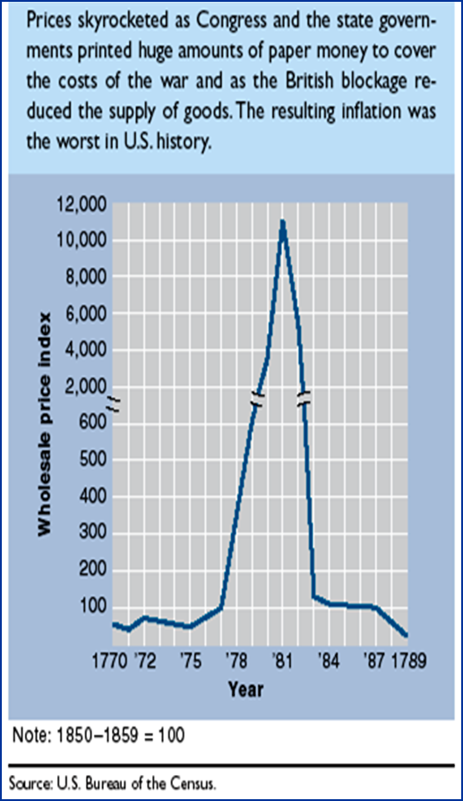
Economic Issues
1780’s ability of national government to collect money was limited
Interest on debt piling up, nation’s credit evaporating abroad
States had trade disagreements, levying duties on goods from neighbors, states issued depreciated paper currency
1784-1786- low point for new republic
British flood Americas with cheap goods, American industry suffered

Slide 12
Political Issues
America more a name than nation
New patriot elite open to ideas of experimentation and innovation in government
13 sovereign states coined money, raised armies, erected tariff barriers
Main problem- what to do with western lands?
Some states had holdings west of Allegheny Mts., some did not
Land rich could sell off land to pay debts, others had to tax heavily to raise revenue

Slide 13
Political Issues
Solution to Land issue:
States eventually surrendered land to central government
Land Ordinance of 1785, Northwest Ordinance 1787
Used to make future states
Result was that it bonded union to central authority
Pioneers bought land from federal government, benefit to nation
Weakened state powers

Slide 14
Political Issues
Articles of Confederation
Loose confederation, acted together to deal with common problems (foreign defense)
No executive, judiciary left up to states
Each state one vote
Hard to amend
No power to regulate commerce, states had different trade laws
No power to tax, states paid what they wanted
National government could not control states
Positives of Confederation- Outlined general powers of government, provided idea of union, dealt with land issue

Slide 15
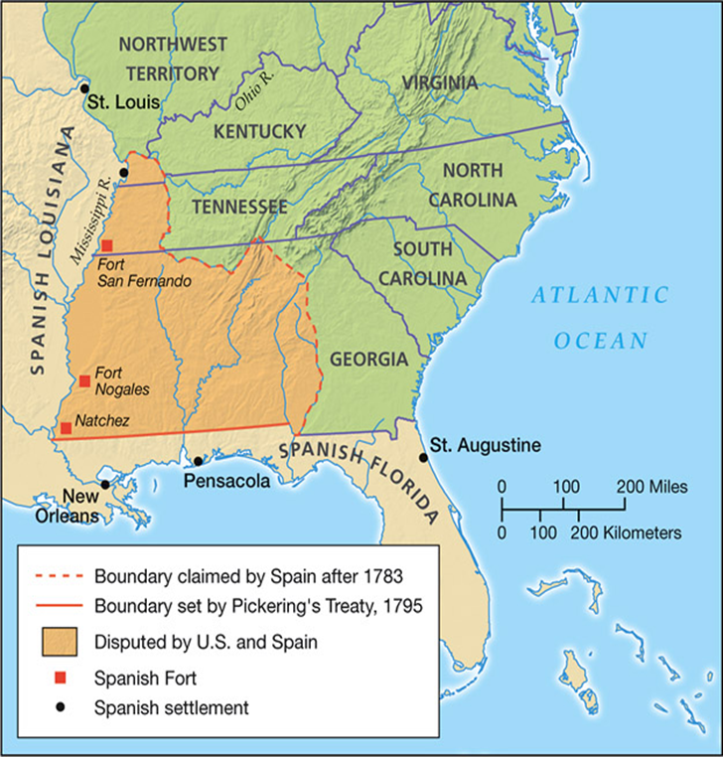
Foreign Problems
British
refused to repeal navigation laws, closed trade to US in the West Indies
Along northern frontier held trading posts on US soil, agitated Indians that kept US from effectively settling territory
Spain
openly unfriendly to US
1784- Closed MS River, people in KY, TN and Old Northwest could not ship goods
Claimed large area of territory granted to US by British
Schemed with and agitated Indians to be hostile with US settlers
France
demanded payment of debts, restricted trade with West Indies
Barbary Pirates
took American ships, enslaved Yankee sailors
America too poor to bribe officials to get release of sailors
Too weak to stop them

Slide 16
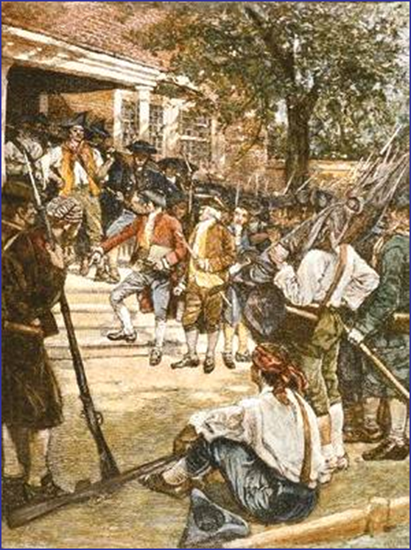
1787 Year of Change
Problems Came to a head in 1786 with Shay’s Rebellion
Annapolis Convention called to amend Articles only 5 states showed up
All colonies called to Philadelphia in 1787 to rewrite Articles and create a stronger central government

Slide 17
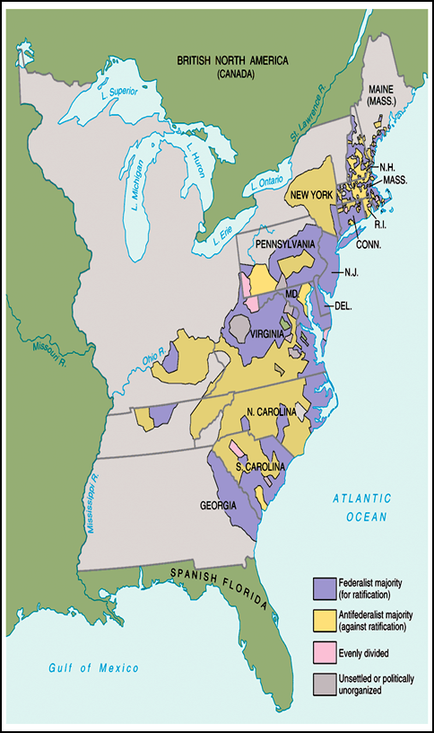
Constitution Making
Delegates (who were they, what were their interests)
Compromises
in representation
Issues between nationalists and states rights advocates
Sectional Issues (trade, slavery)
voting
Who really had the power and why (all people or a few)?
Ratifying
Opposing groups and reasons behind opposition
Who were the Federalists and antifederalists
Virginia, New York, Federalist Papers, Bill of Rights
Why did Federalists win?

Slide 18
2 Revolutions
Minority won twice-
1. Revolution to get rid of British
2. Peaceful revolution to overthrow government (under Articles)
Only ¼ of adult males had property to vote
Conservatism had erected safeguards against mob rule, republican gains of revolution conserved, federalists restored economic and political stability
Every branch of government represented by the people (though indirectly in some cases), self limiting system of checks and balances

