Slide 1
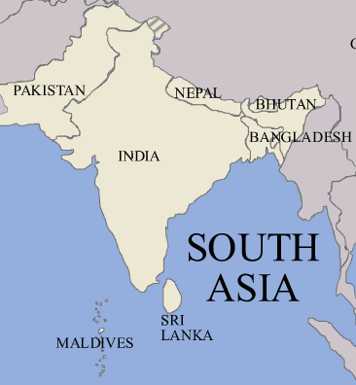
South Asia

Slide 2
South Asia as a Region
Separated from the rest of Asia by the Himalayas
Great river systems (Ganges, Indus)
Variety of climates from deserts to highlands
Effected by seasonal monsoons
Two of world’s major religions founded there (Buddhism, Hinduism)
High population growth and low standard of living

Slide 3
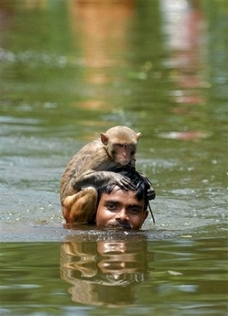
Physical Geography of South Asia

Slide 4
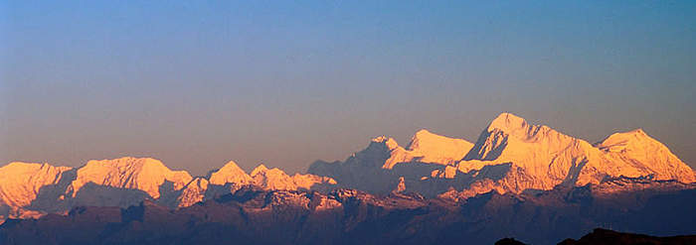
Physical Geography of South Asia
Region is known as the subcontinent
Made up of main land and island countries
Varied landscape
Himalayas formed when sub continent collided with southern Asia
Highest and youngest mountains in the world (Mt. Everest 29,000 + feet)

Slide 5
Physical Geography of South Asia
Other mountain ranges
Karakoram
Hindu Kush
Invaders had to go through mountain passes, protected the region from outsiders (Khyber Pass)
South of mountains broad, flat river plains formed by the Ganges and Brahmaputra Rivers
Good for agriculture, contributed to population growth
Eastern Ghats, Western Ghats mountain ranges in India between them is the Deccan Plateau,
W. Ghats keep monsoon rainfall from region makes it extremely dry

Slide 6
Physical Geography of South Asia
Central India Vindhya Mts.
Distinct cultures developed north and south of mountains
Islands
Sri Lanka island broke away from original Indian landmass
Maldives island chain of coral atolls
116 sq. mi. of land area

Slide 7
Physical Geography of South Asia
Major River Systems
Major rivers begin in the Himalayas
Fan out across subcontinent
Provide drinking water, fertile soil for crops, hydroelectric power
Water resource management a problem because rivers cross different countries with different needs
Indus River- flows across Pakistan, had one of the world’s earliest civilizations
Brahmaputra River- provides hydroelectric power for Bangladesh
Ganges- most important river in S. Asia
Water considered sacred by Hindus
Most agriculturally productive area of country
Worlds longest alluvial plain
Most densely populated area in India

Slide 9
Climate and Vegetation
Vary from tropical, desert, highland climates
Tropical rainforest found along coast and Bangladesh
Tropical savanna found in central India (wet/dry seasons)
Highland climate found in Himalayas
Lower Indus River arid climate Great Thar Desert
Steppe climate found on the Deccan Plateau
Ghats block rainfall make area relatively arid

Slide 10
Climate and Vegetation
Monsoons
Much of region has three distinct seasons
Hot (Feb- June)
Wet (June- Sept)
Cool (Oct-Feb)
Depend on seasonal winds (monsoons)
Cool season dry winds blow from the north
Hot season triggers change in wind direction, causes moist air from ocean to blow over region brings monsoon rains

Slide 11
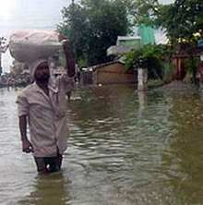
Monsoon Rains
Himalayan Mts. Block winds during wet season, rains spread out across Ganges Plain
High temperature can cause crops to dry up, too much rain causes flooding and death
Monsoon rains do not fall evenly across region
Cyclones, earthquakes are natural disasters that affect the region

Slide 12
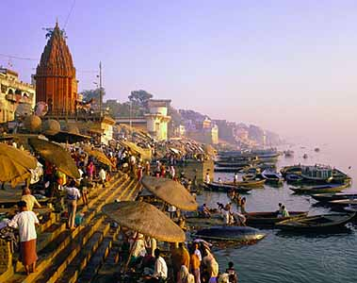
Cultural Geography of South Asia

Slide 13
India
1.1 billion people in India
15% of world’s population
Diversity of religions and languages
Caused tolerance and conflict through time
India
People from diverse groups (Dravidians, Aryans, British)
Many identify themselves by religion (Hindu, Muslim, Sikh, Buddhist, Jains)
Also by jhati (defines social status, occupation

Slide 15
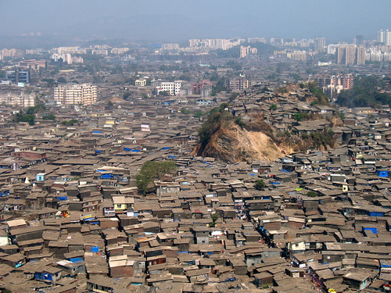
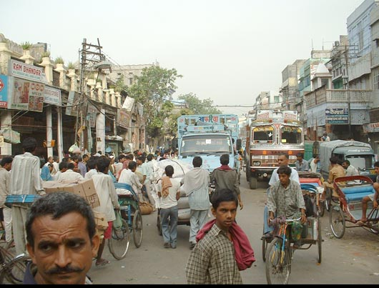
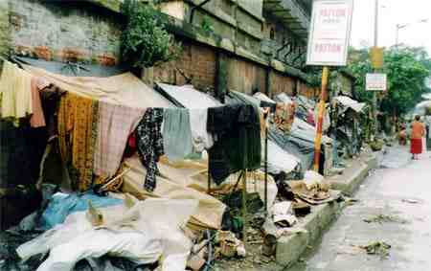
India
Average population density is 7 times the world average
Highest population density is along the fertile plains of the Ganges River
Most population is rural
Recent years growing number moving to urban areas
Better jobs, wages
Strain to public resources and facilities
Many cities among the world’s most densely populated
Largest city Mumbai- leading industrial, financial and filmmaking center
Calcutta- port city on the Ganges
Delhi- Huge land area
Part of a megalopolis (string of closely linked metropolitan areas)

Slide 16
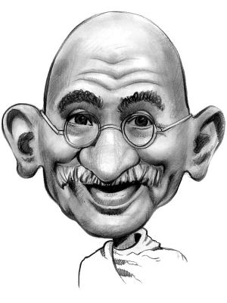
India
Series of invaders came over the Khyber Pass
Mauryan Empire- greatest ruler Asoka
Promoted Buddhism and nonviolence
Gupta Empire- achievement in math, science and the arts
AD 700 Muslims entered region dominated region for several centuries
Europeans arrived 1500’s
British controlled region by 1700’s
British influence influenced elements of Indian culture (language, government)
Modern South Asia
Mid 1900’s Gandhi fights for Indian independence from British
Uses non-violence
1947 British leave
Hindu majority India, Muslim majority East and West Pakistan
India is today the world’s largest democracy

Slide 17
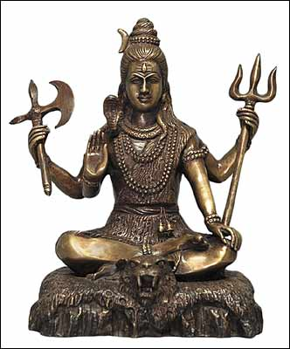
Cultural Geography
Two major religions had origins in region
Hinduism
Way of life and religion
Belief in dharma, karma, reincarnation
Goal of individual to end cycle of rebirth through good deeds
Many gods, goddesses- forms of one eternal being
Tolerant of other religions, view them as different paths to same goal

Slide 18
Cultural Geography
Buddhism
Founded by Siddhartha Gautama (a Hindu Nobel) 550 BC
Left good life behind to seek Truth
Finally achieved enlightenment
Teaches that attachment to this world leads to suffering
Follow Middle Way to achieve enlightenment
Little ritual
Less social control in Buddhism appealed to lower social classes

Slide 19
Cultures and Lifestyles
Other Religions
Jainism- strict non violence, everything has a soul
Sikhism- one God, good deeds bring release from cycle of reincarnation
Sikhs want a separate state
See religion in everyday life, people are surrounded by it
Prayer flags in Nepal, Sadhus (holy men) on the streets in India, women covering their head in the Islamic tradition
Many religious groups have tried to influence government

Slide 20
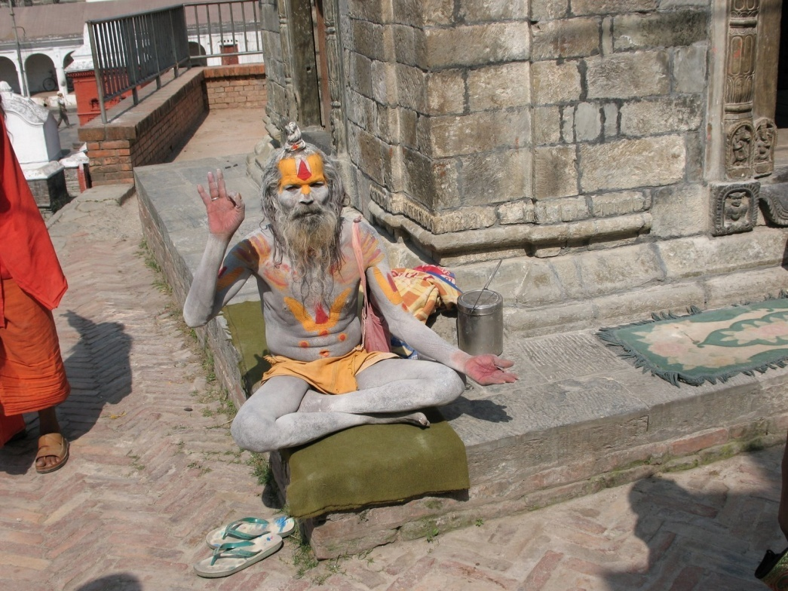
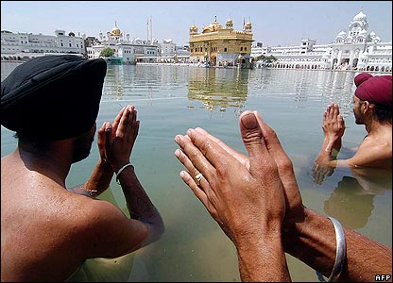
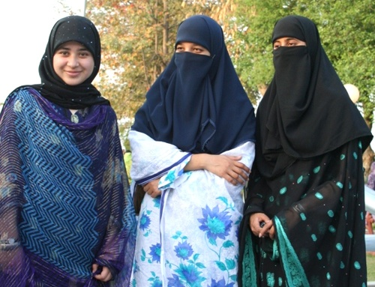

Slide 21
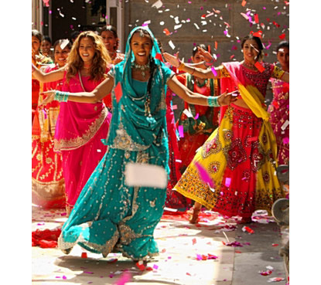
India
Lifestyle a complicated mix of modern and traditional
Average literacy rate is 65%
Recently government has committed itself to education of lower classes
18 official languages with Hindi and English the most widespread
Motion picture industry centered in Mumbai known as Bollywood produces more feature length films than any other country

Slide 22
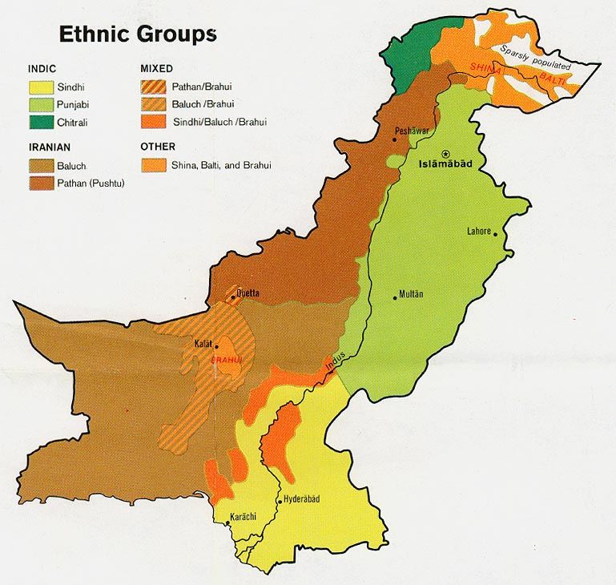
Pakistan and Bangladesh
Share Muslim faith and rural existence
Pakistan has 5 different ethnic groups, ethnic identity can be complex based on ethnicity, religion and language
Most people in Bangladesh are Bengali and Muslim

Slide 23
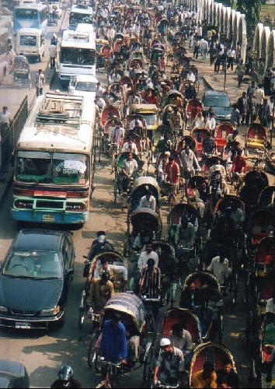
Pakistan and Bangladesh
Bangladesh most densely populated country in South Asia
Capital Dhaka is the third most densely populated city in the world
Country has difficulty feeding their population
Recently the fertility rate has declined and population levels have dropped off
Government provides loans to women to start small businesses to improve their lives and have smaller families
Pakistan is the most urbanized country in South Asia
Growing cities have problems with pollution and housing shortages
Largest cities are Karachi and Islamabad

Slide 25
Pakistan and Bangladesh
2500 B.C. One of the world’s great civilizations began in the Indus river valley in Pakistan, around 1700 B.C. it decline due to environmental changes
Muslim invaders and traders brought Islam to Pakistan and Bangladesh
When granted independence by British in 1947 a separate Muslim state was established
East and West Pakistan were separated from Hindu India
They became separate countries in 1971
Pakistan has had a history of political instability and military rule
In Bangladesh political and ethnic difficulties have made stable rule difficult

Slide 26
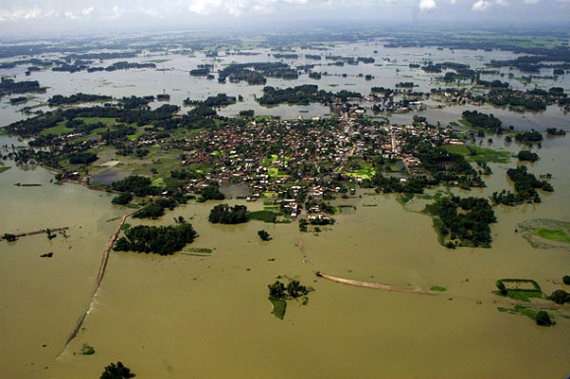
Pakistan and Bangladesh
Education in both countries has lagged far behind the rest of South Asia
Literacy rates are 48% in Bangladesh and 45% in Pakistan
The rate for females is lower
Social and cultural barriers exist that make education for women difficult
Health care in both countries is poor
Bangladesh is a flat river flood plain and faces serious threats from waterborne disease, especially during the monsoon season
The official language in Pakistan is Urdu, but most speak Punjabi or English
The official language of Bangladesh is Bangala
Over 90% of the population of both countries is Muslim

Slide 27
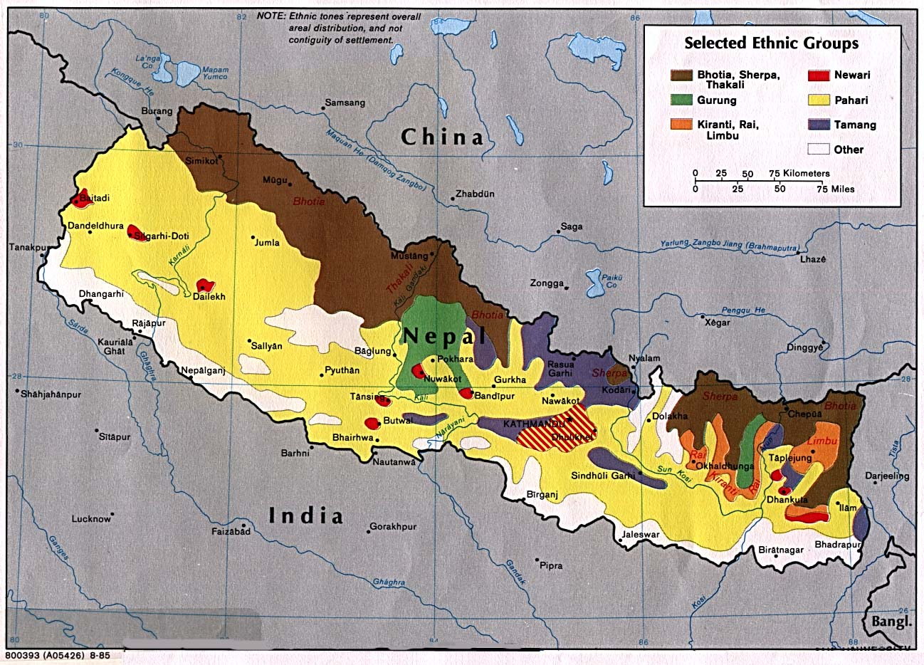
Nepal and Bhutan
These countries reveal ethnic and religious differences in the region
Both countries are very mountainous and rural
Nepal is a complex mix of ethnic groups, two main groups are Indo-Nepalese from the south and Tibeto-Nepalese who migrated from the north
Most famous ethnic group are Sherpa's who are known for their mountain climbing skills
People of Bhutan are Bhote people that are related to the Tibetan people

Slide 28
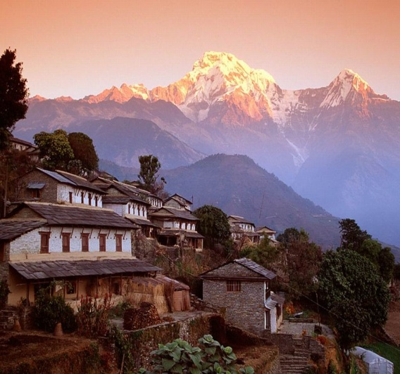
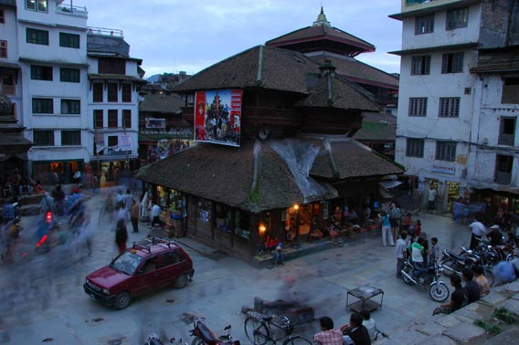
Nepal and Bhutan
Population density in both countries decreases as the elevation increases
Most densely populated area of Nepal is the Katmandu Valley
Nepal always remained free from colonial powers
Bhutan has always been influenced by Buddhism, today it is a Buddhist kingdom
Bhutan and Nepal have low literacy rates and access to health care is low
Many people rely on traditional medicine and the life expectancy is low

Slide 29
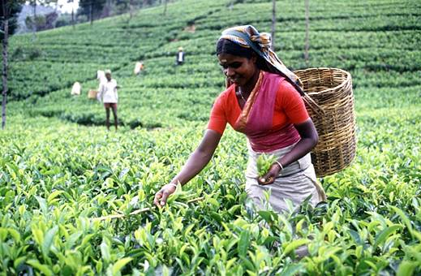
Sri Lanka
Indian, Arab and European countries have shaped the history of Sri Lanka
Traders came for the spices and to take advantage of its strategic position on trade routes
Government is heavily influenced by British and Dutch legal systems
British developed a plantation economy based on tea, rubber and coconuts
Achieved independence from Britain in 1972
Today the country has a Parliamentary democracy
Buddhism is the dominant religion but it has been the cause of civil strife in the country

Slide 30
Sri Lanka Sinhalese and Tamils
Sinhalese and Tamils two ethnic groups in Sri Lanka
Speak different languages, practice different religions
Sinhalese (Hindu), Tamils (Buddhist)
Tamils fighting for independent state
Tamil Tigers violent separatist group
Disrupted island economy
Over 60,000 have been killed over the last 30 years

Slide 31
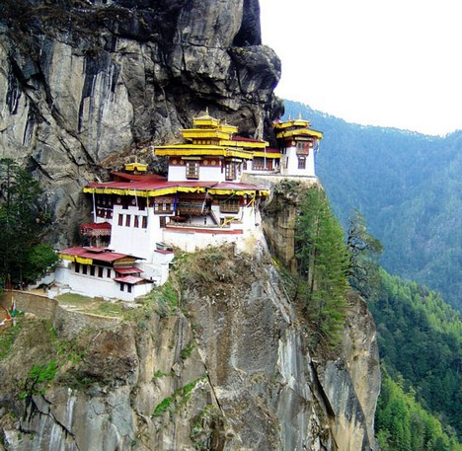
South Asia Today

Slide 32
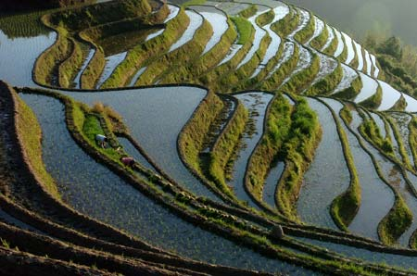
The Economy
Most are subsistence farmers
Lack of technology, farmers use labor intensive methods
Different farming methods used depending on topography
Most farms are very small
Sri Lanka large plantations founded by Europeans (tea, rubber)
Plantations employ ¾ of countries workers, allow little room for food crops

Slide 33
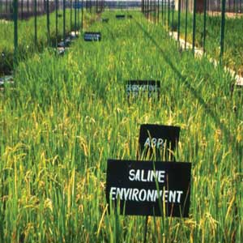
South Asian Crops
Tea, rubber, coconuts, cotton cash crops (for sale or export)
Grains- rice, wheat provide most food for people
Agricultural improvements- feeding population enormous challenge
Technology and training used to increase food production
Green Revolution- since 1960’s
Dramatically improved crop yields
managed irrigation, high yielding seeds
Negatives of Green Revolution
Mechanization and chemicals expensive
Farmers get caught in cycle of needing more chemicals to keep crop yields high

Slide 34
The Economy
Industrialization began under British rule and was funded by Europeans
After independence India turned its back on foreign investment to become more self sufficient
Saw an economic slowdown and began to open up to foreign investment in the 1990’s
Economic growth sparked growth of middle class and also led to a growing gap between rich and poor
Allowed India to become part of the global economy

Slide 35
South Asian Industry
Since late 1990’s service industry has become more important (government services, retail sector)
High technology jobs computer, communications, aerospace industry
Indian computer professionals in demand around the world
Hyderabad “Silicon Valley” of India, large exporter of computer software
Bangladesh in 1970’s began giving small loans to people in rural areas , this has played a role in reducing poverty in rural regions
Tourism important in Nepal
Ecotourism becoming important, can support preservation and contribute to economies

Slide 36
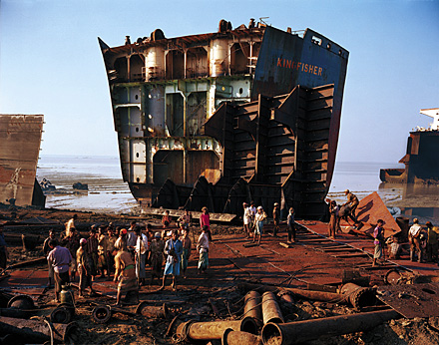
South Asian Industry
Heavy Industry geared toward mass production (iron, steel, cement, heavy machinery)
Bangladesh- major industry recycles iron, steel called “shipbreaking”
Workers dismantle aging damaged ships and melt down metal parts

Slide 37
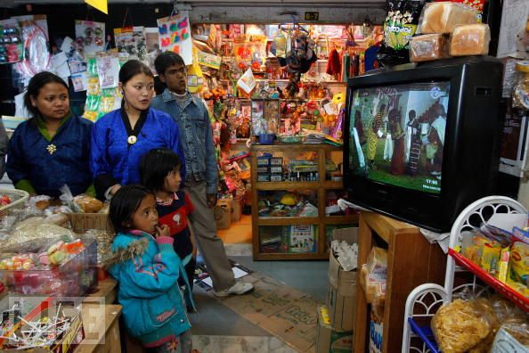
Transportation and Communication
Transportation is crucial to financial systems of region
Vary widely
Nepal and Bhutan have the least developed transportation networks and India has the best
Newspapers in India, Pakistan and Bangladesh are outspoken on many issues
Nepal and Bhutan restricts media control to prevent the influence of outside culture
1999 first television and internet service in Bhutan
India region leader in internet service

Slide 38
Trade and Interdependence
Long standing political rivalries between India and Pakistan have affected the regions economic ties
Rapid economic growth may ease cultural tension
India has the regions largest economy, Nepal and Bhutan depend on India for a majority of their trade
2004 South Asia Free Trade Agreement went into effect but disagreement over tariffs between India and Pakistan has kept it from being effective
India has made trade agreements with other countries and is now a major trading partner with China and the European Union
Nepal is trying to reduce their dependence on Indian trade

Slide 39
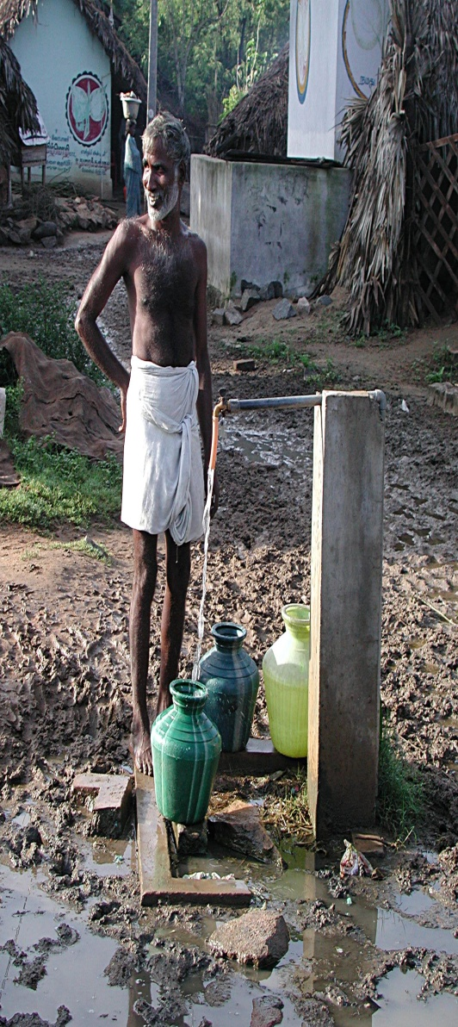
People and Their Environment
Key to resource management in South Asia is sustainable development to keep resources for future generations
Lack of access to clean water a constant problem in South Asia
Scarcity of clean water causes high rates of death from waterborne disease
Less than 60% of urban population and 20% of rural population has access to clean water
Building dams is a way to manage water resources
To control irrigation and to use water for irrigation and provide hydroelectric power
Dam building displaces whole villages and causes harm to ecosystems

Slide 40
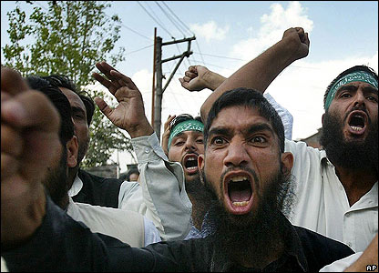
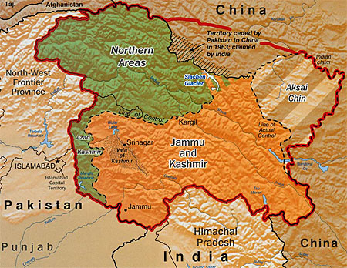
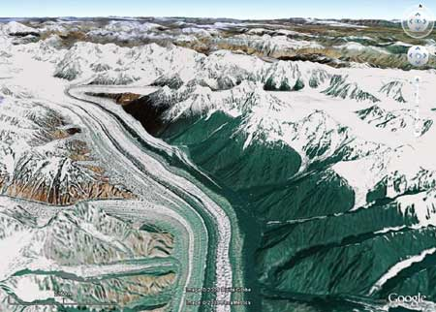
Cultural Geography
Regional Conflicts
Tension between Pakistan and India still exists (Kashmir Region)
1998 both countries develop nuclear weapons, adds to complexity of conflict
Hindus and Muslims clash across region

Slide 41
People and their Environment
Social Issues
Many related to religion and national autonomy (Kashmir, Sri Lanka, Nepal, Pakistan)
Concerns of nuclear proliferation between India and Pakistan
Suffers from legacy of caste system, lowest castes still discriminated against
Technically caste system outlawed in India

