Slide 1
The Constitution

Slide 2
Learning Objectives
The Origins of the Constitution
The Government That Failed: 1776–1787
Making a Constitution: The Philadelphia Convention
Critical Issues at the Convention
The Madisonian System
Ratifying the Constitution
Changing the Constitution
Understanding the Constitution

Slide 3
Origins of the Constitution
The Road to Revolution
Colonists faced tax increases after the French and Indian War.
Colonists lacked direct representation in parliament.
Colonial leaders formed the Continental Congress to address abuses of the English Crown.

Slide 4
Origins of the Constitution

Slide 5
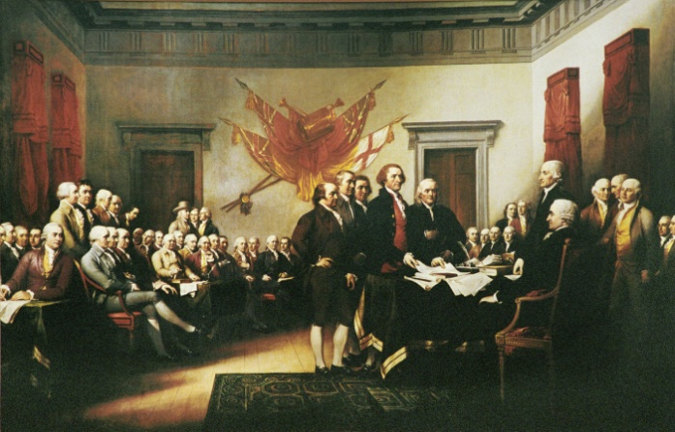
Origins of the Constitution
Declaring Independence
In May and June 1776, the Continental Congress debated resolutions for independence.
The Declaration of Independence, which listed the colonists grievances against the British, was adopted on July 4, 1776.
Politically, the Declaration was a polemic, announcing and justifying revolution

Slide 6
Origins of the Constitution
The English Heritage: The Power of Ideas
Natural Rights – Rights inherent in humans being, not dependent on government.
Consent of the Governed – The government derives its authority by sanction of the people.
Limited Government – Put certain restrictions on government to protect natural rights.

Slide 7
Origins of the Constitution
The American Creed
The sanctity of property was one of the few ideas absent in Jefferson’s draft of the Declaration of Independence.
Jefferson altered Locke’s phrase, “life, liberty, and property” to “life, liberty, and the pursuit of happiness.”

Slide 8
Origins of the Constitution

Slide 9
Origins of the Constitution
Winning Independence
In 1783, the American colonies prevailed in their war against England.
The “Conservative” Revolution
Restored rights the colonists felt they had lost
Not a major change of lifestyles

Slide 10
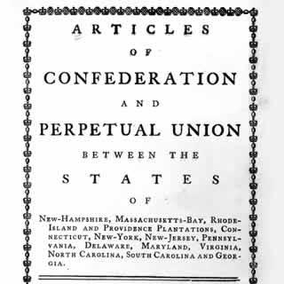
The Government that Failed
The Articles of Confederation
The first document to govern the United States, ratified in 1781.
It created a confederation among 13 states and former colonies.
Congress had few powers; there was no president or national court system.
All government power rested in the states

Slide 11
The Government that Failed
Changes in the States
Voting laws increased political power among a new middle class.
Middle class of farmers and craft workers counterbalanced the power of professionals and wealthy merchants.
Ideas of equality spread and democracy took hold.

Slide 12
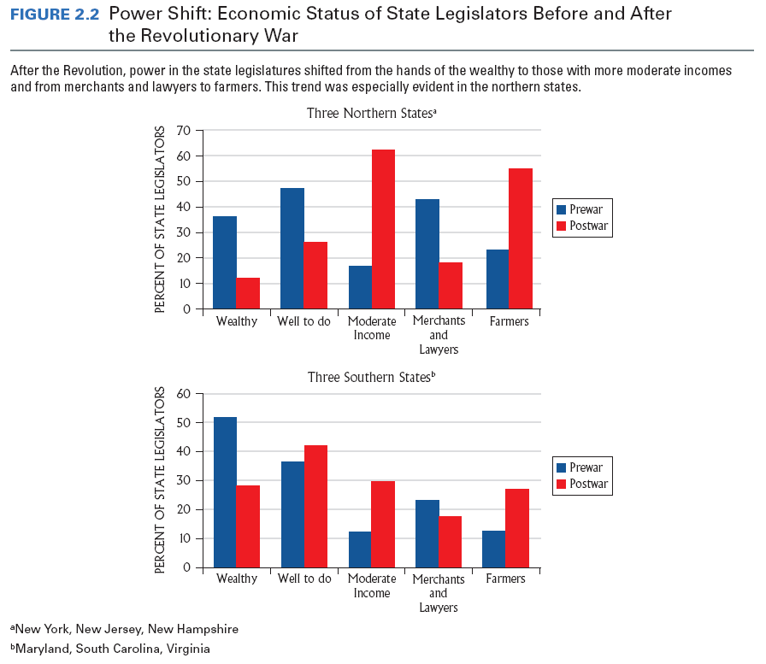
The Government that Failed

Slide 13
The Government that Failed
Economic Turmoil
Postwar depression left farmers unable to pay debts.
State legislatures sympathetic to farmers passed laws that favored debtors over creditors.

Slide 14
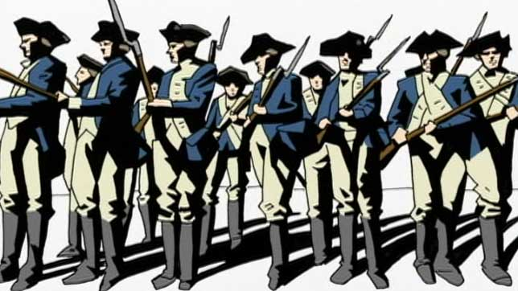
The Government that Failed
Economic Turmoil
In 1786, a group of farmers in western Massachusetts led by Captain Daniel Shays rebelled at losing their land to creditors.
Shays’ Rebellion was a series of armed attacks on courthouses to prevent judges from foreclosing on farms and it spurred the birth of the Constitution.

Slide 15
The Government that Failed
The Aborted Annapolis Meeting
An attempt to discuss changes to the Articles of Confederation in September 1786.
Attended by only 12 delegates from 5 states.
Called for a meeting in May 1787 to further discuss changes—the Constitutional Convention.

Slide 16
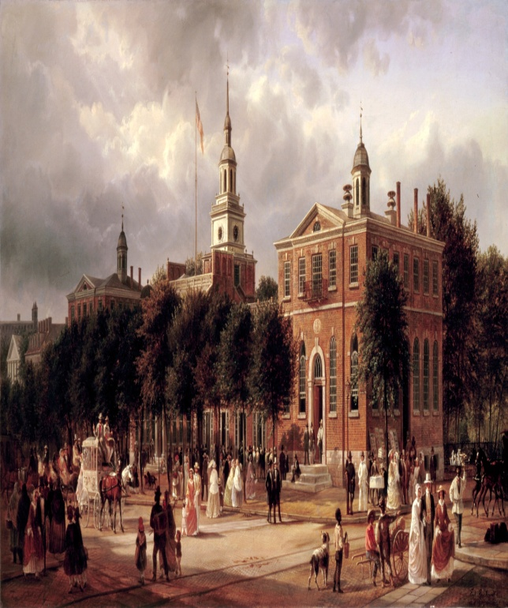
Making a Constitution: The Philadelphia Convention
Gentlemen in Philadelphia
55 men from 12 of the 13 states.
Mostly wealthy planters and merchants.
Most were college graduates with some political experience.
Many were coastal residents from the larger cities, not the rural areas

Slide 17
Making a Constitution: The Philadelphia Convention
Philosophy into Action
Human Nature – People were self-interested; government should check and contain the natural self-interest of people.
Political Conflict – Wealth (property) distribution is the source of political conflict; factions arise from the unequal distribution of wealth.

Slide 18
Making a Constitution: The Philadelphia Convention
Philosophy into Action (cont.)
Objects of Government – Property must be protected against the tyranny of faction.
Nature of Government – Secret of good government is “balanced government” because as long as no faction could seize complete control of government, tyranny could be avoided.

Slide 19
Critical Issues at the Convention
The Equality Issues
Equality and Representation of the States – The New Jersey Plan and Virginia Plan led to the Connecticut Compromise.
Slavery – The question of how to count slaves was solved with the Three-Fifths Compromise.
Equality in Voting – Delegates decided to leave voting qualifications to the states

Slide 20
Critical Issues at the Convention

Slide 21
Critical Issues at the Convention
The Economic Issues
States had tariffs on products from other states.
Paper money was basically worthless.
Congress could not raise money.
Key actions taken – Powers of Congress were strengthened and powers of states were limited.

Slide 22
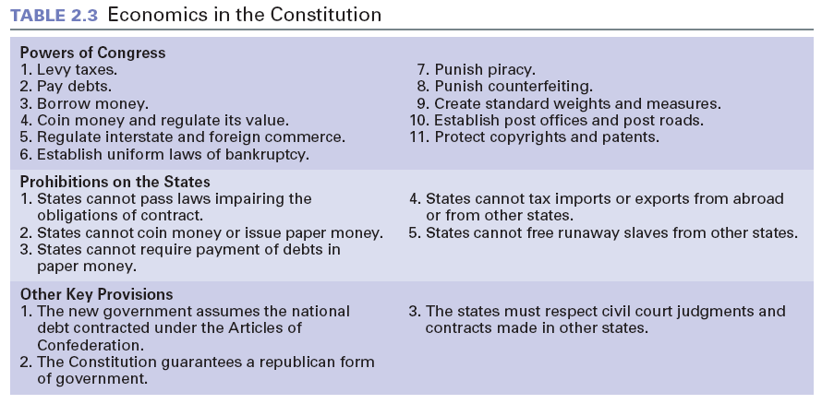
Critical Issues at the Convention

Slide 23
Critical Issues at the Convention
The Individual Rights Issues
Prohibits suspension of writ of habeas corpus.
No bills of attainder.
No ex post facto laws.
Religious qualifications for holding office prohibited.
Strict rules of evidence for conviction of treason.
Jury trial in criminal cases.

Slide 24
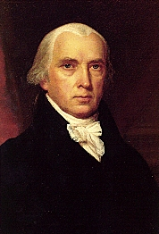
The Madisonian System
Thwarting Tyranny of the Majority
Limiting Majority Control – To keep most of the government beyond the control of the masses.
Separating Powers – Branches are relatively independent of the others so no single branch could control the others.

Slide 25
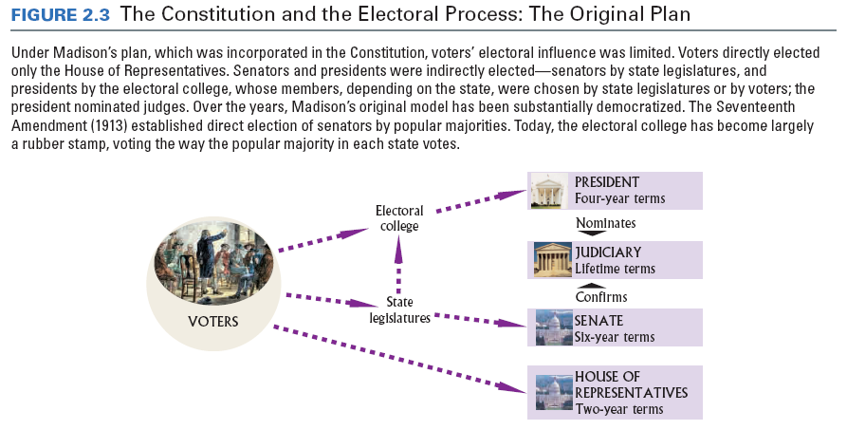
The Madisonian System

Slide 26
The Madisonian System
Thwarting Tyranny of the Majority (cont.)
Creating Checks and Balances – Each branch needs the consent of the others for many actions.
Establishing a Federal System – Federalism divides power between national and state governments.

Slide 27
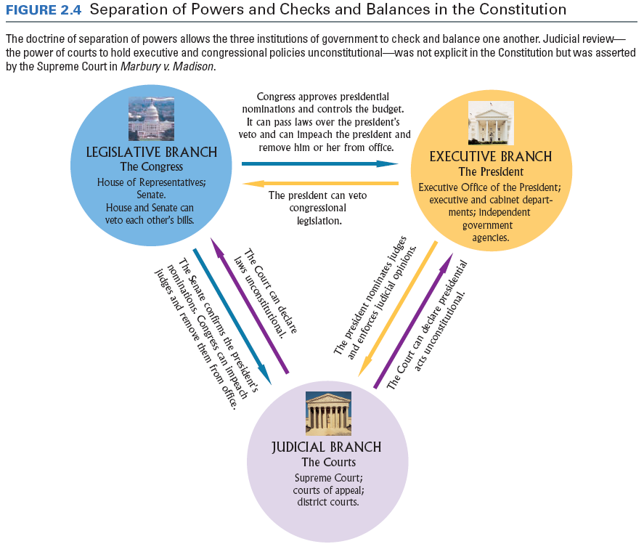

Slide 28
The Madisonian System
The Constitutional Republic
Republic is a form of government in which the people select representatives to govern them and make laws.
Tends to favor the status quo and limit political change.
The End of the Beginning
The document was approved and now it had to be ratified.

