Slide 1
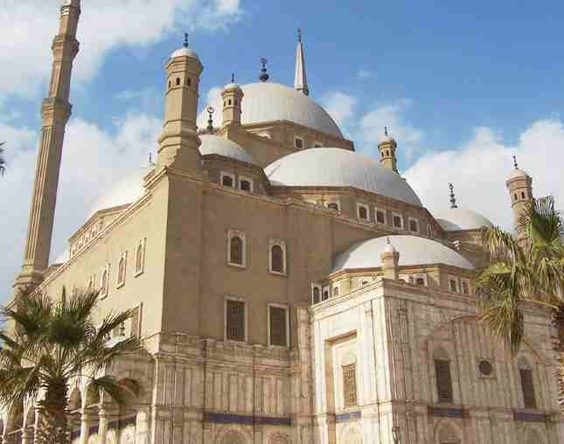
The Muslim World Expands
1300-1700

Slide 2
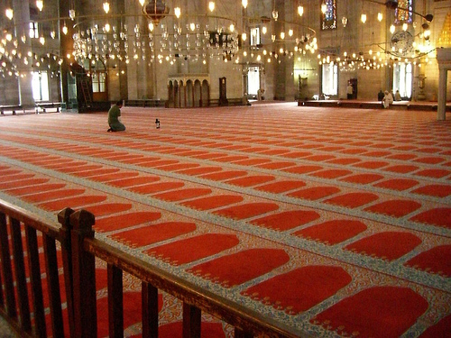
Ottomans Build a Vast Empire

Slide 3
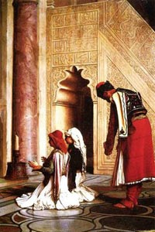
The Ottomans Build a Vast Empire
1300’s Turks began to expand out of Anatolia in central Turkey
Began to unify under a single leader, Osman
Turkish warriors called ghazis, warriors for Islam and followed Islamic code, ruled by a sultan
Turks success was based on the use of gunpowder
Conquered people were treated fairly
Ruled through local officials appointed by sultan, non-Muslim locals did not have to serve in the army but paid taxes
1402- Ottoman expansion was halted by warriors from central Asia under Timur the Lame

Slide 4
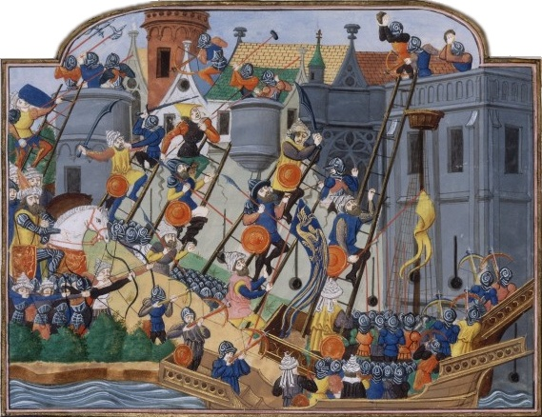
The Ottomans Builds a Vast Empire
Expansion of the Ottoman Empire
After threat from Timur ended Ottoman sultan Mehmed I took power
Son, Mehmed II defeated the Venetian, Italian and Hungarian armies
1453- Mehmed the Conqueror took the city Constantinople
City was strategic point between the Black Sea and the Mediterranean,
allowed the empire to expand into Asia,
united empire between Europe and Asia
Opened city up to Muslims, Christians, Jews, renamed city Istanbul

Slide 5
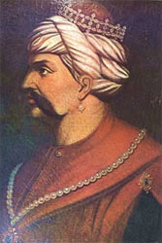
Ottomans Build a Vast Empire
1512- Selim the Grim came to power
Defeated Safavid Empire in Persia and conquered Syria, Palestine, North Africa
Conquered Cairo the intellectual center of the Islamic world
Conquered Mecca and Medina the holiest cities of Islam

Slide 6
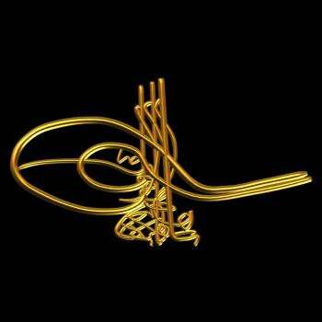
Ottomans Build a Vast Empire
1520- Suleyman the Lawgiver becomes sultan
Under his rule empire reached its greatest power
Captured part of eastern Europe, and islands in the Mediterranean , dominated the eastern Mediterranean sea
Used powerful navy to control North African coastal cities and trade routes to the interior of Africa
1526- advanced into central Europe and made Europeans panic
Suleyman became the most powerful monarch on the planet

Slide 7
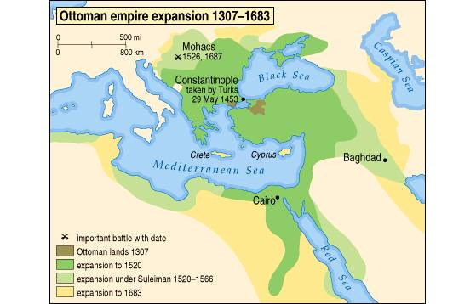

Slide 8
Ottomans Build a Vast Empire
Suleyman kept diverse empire together
Simplified and systematized government and law codes
Slaves ran the government
Devshirme system drafted boys from conquered Christian territories, gave them education, converted them to Islam and trained them as soldiers
Elites soliders known as janissaries
Brightest rose to high positions in government and military
Ottomans let conquered territories keep their religion and local practices to keep down conflict

Slide 9
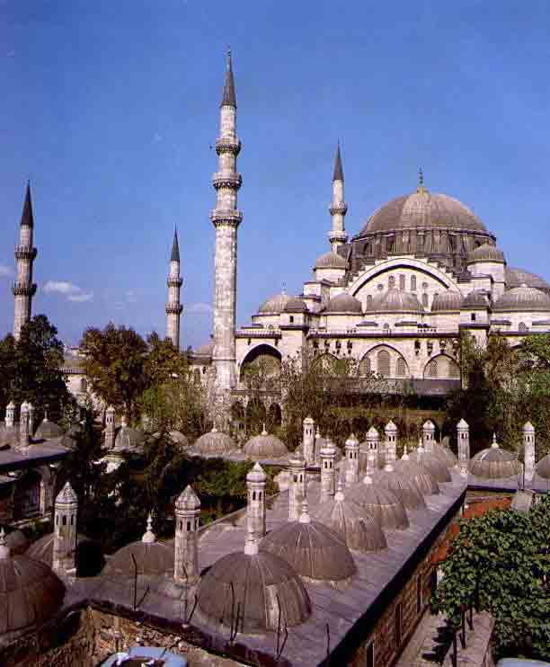
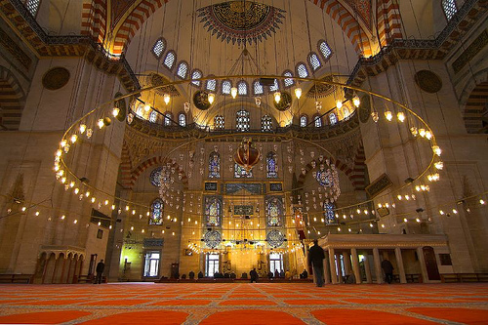
Ottomans Build a Vast Empire
Suleyman promoted art, architecture and poetry in his empire
Creative period similar to European Renaissance
Painters and poets looked to classical Persia and Arabia for inspiration
Empire slowly declined over next 400 years
Sultans had a tradition of killing ablest sons so they would not take power from them
Did not educate other sons and this led to a line of weak rulers
Empire was officially broken up at end of World War I (1917)

Slide 10
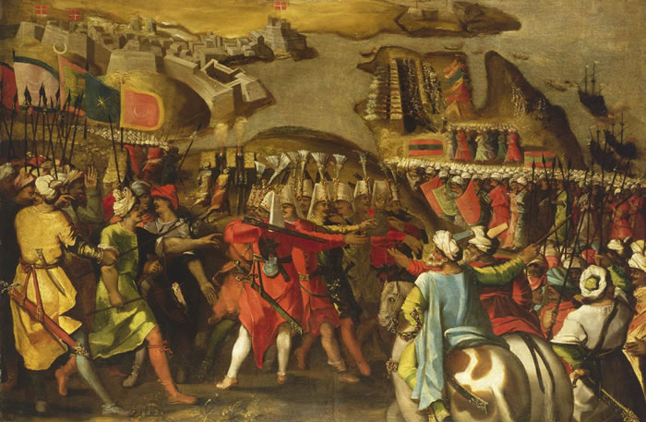
Ottoman and European Culture Exchange
Exchange of European and Ottoman ideas and customs
Officials and merchants copied dress, habits, lifestyles of Europeans
Europeans copied Ottoman military technology, decorated homes with rugs, pottery, etc.

Slide 11
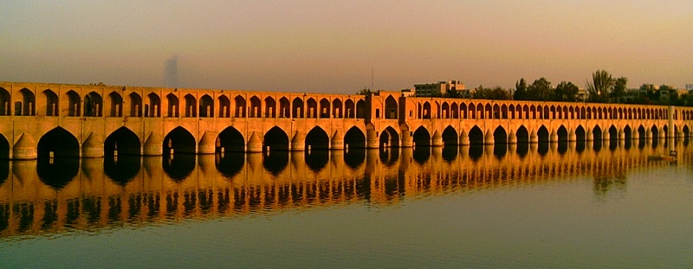
The Safavid Empire: Cultural

Slide 12
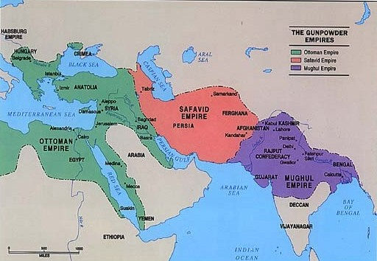
Safavid Empire
Safavid Empire ruled Persia between 16th and 18th centuries
Thrived by blending traditions of Persians, Ottomans and Arabs

Slide 13
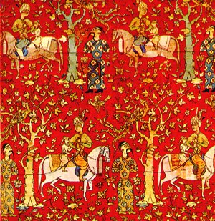
The Safavids Build and Empire
Safavids were an Islamic group
Aligned with Shi’a branch of Islam
Squeezed geographically between Ottoman Empire and Mughal Empire in India
To protect themselves they developed a powerful army
1501 12 year old military leader Isma’il conquered most of what is now Iran and gave himself the title shah
Established Shi’a Islam as the official religion, anybody that did not convert was put to death
1514 Ottomans defeated Safavids and set the border between the two empires

Slide 14
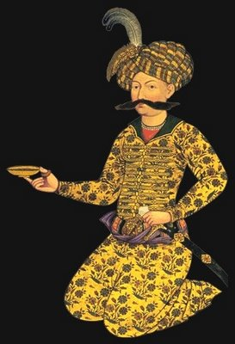
The Safavid Golden Age
Isma’il’s son Tahmsap adopted the Ottoman idea of using artillery with his military forces
Expanded north across the Caucus Mountains and brought Christians under Safavid rule
1587- Shah Abbas takes the throne
Created a “golden age” of Safavid culture that took the best from the Ottomans, Persian and Arab worlds

Slide 15
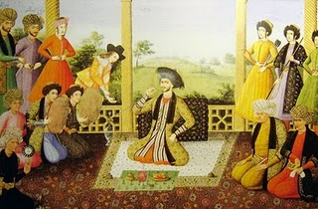
Safavid Golden Age
Shah Abbas reformed military and civilian life
Created army that was loyal only to him
Modeled on idea of janissaries of Ottoman empire
Recruited Christians and equipped the armies with artillery
Reformed government
Punished corruption,
Promoted loyal people
Used foreigners to fill government positions
Invited Christians to move to empire
Expanded industry, trade and art exchanges between empire and Europe

Slide 16
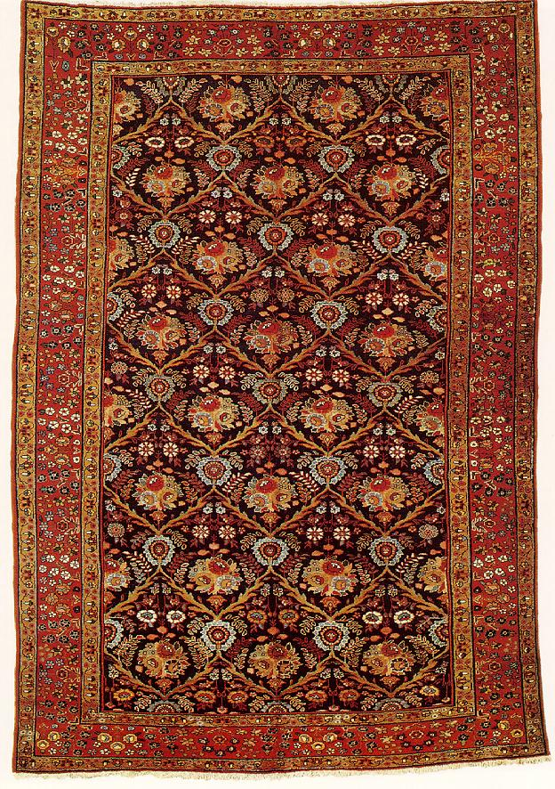
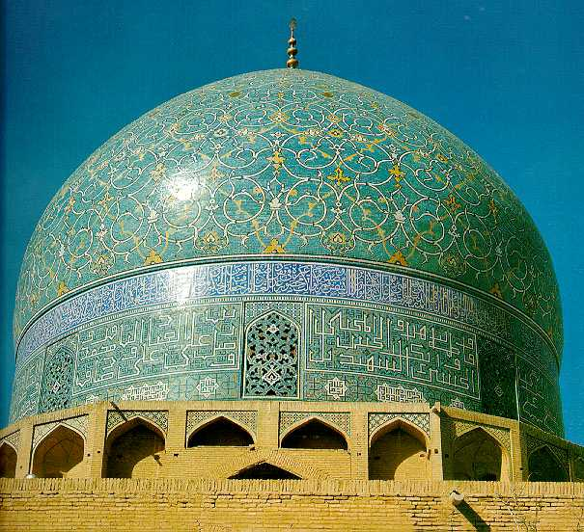
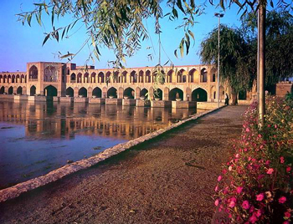
Safavid Golden Age
New capital established at Esfahan
City one of the most beautiful in the world
Many foreign artisans found in the city
Chinese artists produced miniature paintings, pottery, ironworks, tile work that blended Asian and Persian influences
Best known for carpets, became a national industry and were prized by Europeans
Shah Abbas sent artists to train in Italy and their rug designs reflected European influence

Slide 17
Dynasty Declines Quickly
Shah Abbas made same mistakes Ottomans made
Killed and blinded most powerful sons
Led to incompetent grandson leading empire
1747 after Nadir Shah was killed by his own troops the empire fell apart

Slide 18
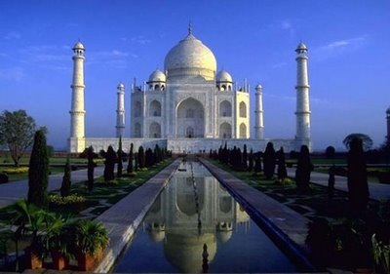
Mughal Empire in India

Slide 19
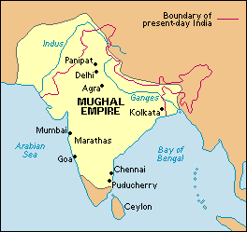
Early History of the Mughals
700’s Muslim tribes form central Asia carved northwestern India into small kingdoms
Descendants of Mongols called themselves Mughals
For over 300 years could only advance as far as the Indus River Valley
Around 1000 they swept into India and conquered the Hindus and ruled from Delhi
1398 Timur the Lame destroyed Delhi

Slide 20
India’s Muslim Empires
Changes to Indian society and government
Turks, Persians, Arabs migrated to India served as soldiers, officials, traders
During Mongol raids of 1200’s many came from Baghdad
1398 Mongols invade , India again fragmented (Hindu/ Muslim)

Slide 21
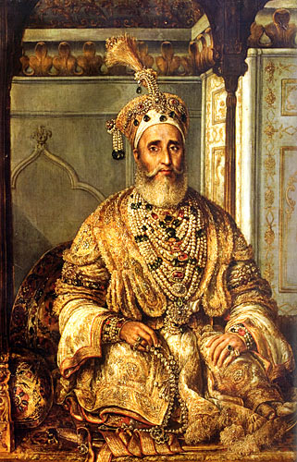
Hindu and Muslim Cultures Collide
Hindu ancient , Islam new
Hindu polytheistic, Islam monotheistic
Hindu caste status, Islam all equal
Sultans allowed Hindu’s to practice religion
Lower castes convert to Islam- message of equality, merchants convert- trade networks

Slide 22
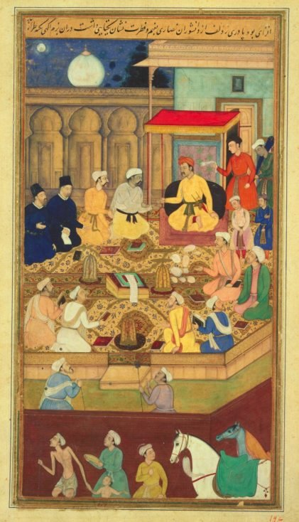
Akbar’s Golden Age
1494 13 year old boy Babur, built up an army and took control of India
1556-1605 Grandson Akbar ruled
Military power based on use of gunpowder and artillery
Akbar continued Muslim tradition of tolerance of religion
Abolished tax on Hindu pilgrims and non-Muslims
Natives and foreigners could rise to high levels in government
Established fair taxes based on wealth
Land policies kept officials from gaining too much power

Slide 23
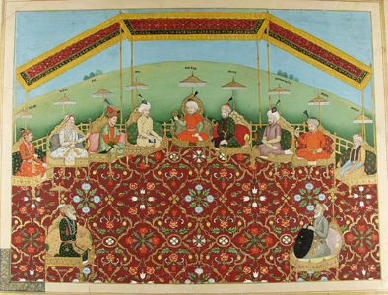
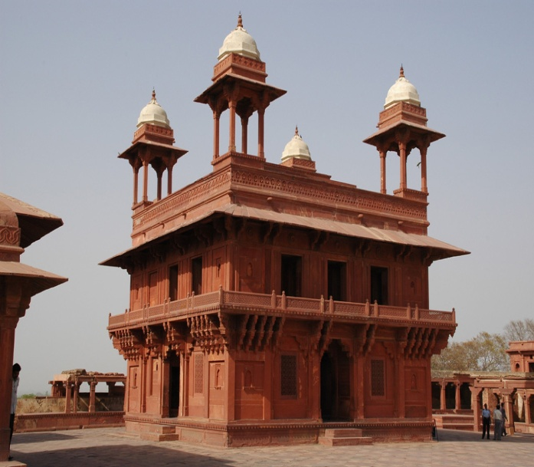
Akbar’s Golden Age
Welcomed influence from many different cultures
Lower castes convert to Islam because message of equality
Merchants convert to take advantage of trade networks and connections
Blended art, education and politics
Official language was Persian, most Indians spoke Hindi
New language developed called Urdu (means from the soldiers camp)
Highly detailed paintings called miniatures illustrated books
Massive temples that portrayed Hindu themes were built under his reign

Slide 24
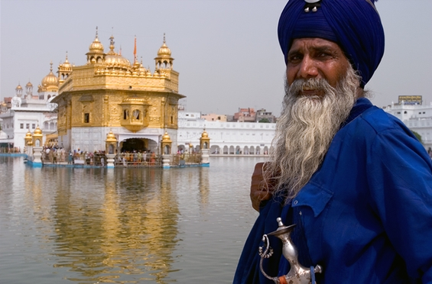
Akbar’s Successors
1605 Akbar dies, son Jahangir becomes emperor
Nur Jahan his wife runs the empire for him
Their son Khusrau rebels and uses the Sikhs to shelter and defend him
Sikhs were a nonviolent religious group with elements of Hinduism and Islam
Because of this the Sikhs became a target for Mughal hatred

Slide 25
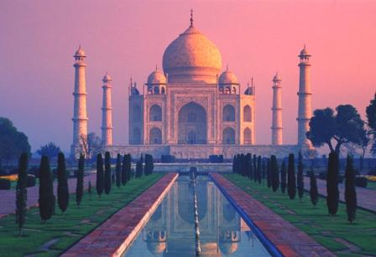
Akbar’s Successors
Shah Jahan, Jahangir’s son took power and assassinated all of his rivals
Passion for two things: his wife and beautiful buildings
Wife Mumtaz Mahal died giving birth and he built shrine to his wife Taj Mahal
While he was building the country suffered
He raised taxes higher and higher to pay for construction of monuments

Slide 26
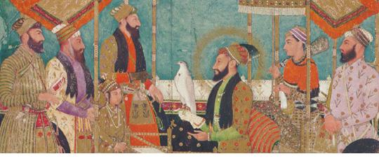
Akbar’s Successors
1657- Shah Jahan grew older and became ill his sons began a civil war to see who would take power
Third son Aurangzeb won and had his father put in prison
Aurangzeb built the Mughal empire to its greatest size
Power weakened during his reign because he was he a cruel ruler
Enforced Islamic laws and did not tolerate Hindu worship
Destroyed all pre-Mughal Hindu shrines, taxed Hindus and removed them from government

Slide 27
Empire’s Decline and Decay
Hindu’s rebelled against policies of Aurangzeb
Raised taxes to keep fighting wars, this led to more rebellion
Drained empire of resources, famine killed 2 million, subjects felt little loyalty
Power of local lords grew and empire was split up
European traders came into region and gained foothold

Slide 28
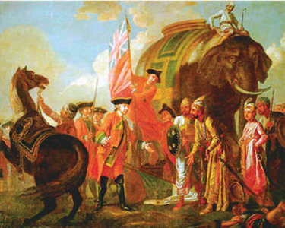
Decline of the Moguls
After death of Shah Jahan revolts against the government and religious intolerance divided India
1650’s British open trade posts (East India Company)
1757 defeat Mogul armies, received right to collect taxes from lands around Calcutta
By 1800 British controlled most of subcontinent

Slide 29
Muslim and Hindu Cultures Blend
New language- Urdu blend of Persian, Arabic, Hindi
New religion- blend of Hindu and Muslim beliefs-Sikhism
Belief of one god, unity of man, reincarnation, rejection of caste

