Slide 1
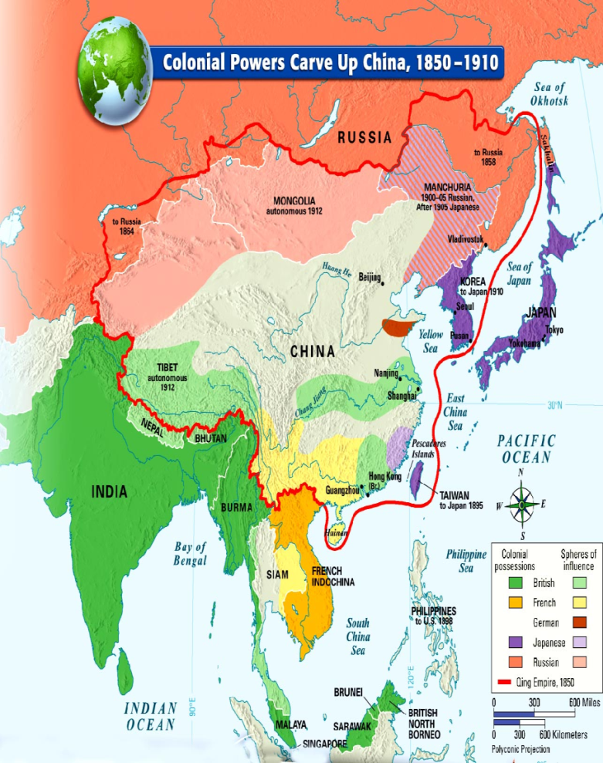
United States Pursues Interests in China
1899 European (Britain, Germany, France , Russia) countries divided China into “spheres of influence”
Each zone the countries had exclusive access to ports and markets
Japan expanded regional influence into China, Korea
U.S. trade limited in China
Feared tariff barriers

Slide 2
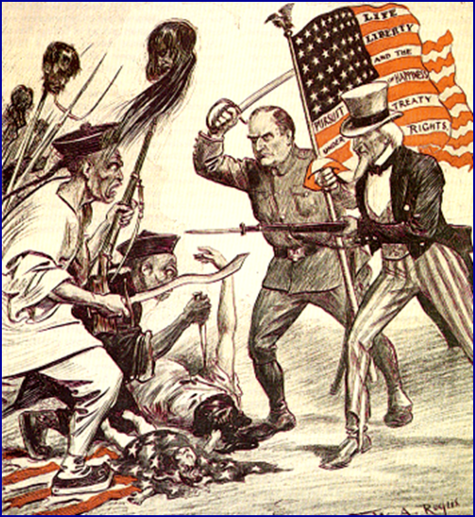
America Demands Equal Trade
1899 U.S Secretary of State John Hay notes on trade in China
U.S asserted they wanted open door policy
Did not want colonies, just free trade and equal access
U.S. expected “equality of treatment for commerce”
Guiding principle for American foreign policy in Asia for years

Slide 3
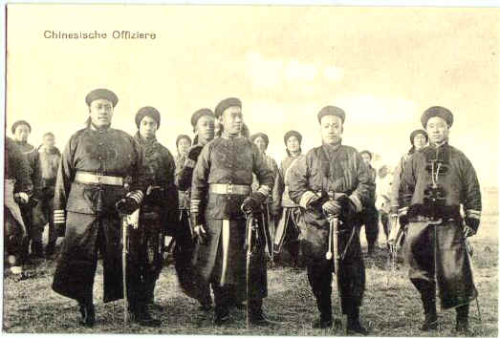
U.S Intervenes in the Boxer Rebellion
Chinese criticized Western culture and influence
May 1900 Chinese anti- imperialist secret society- “Boxers” took over foreign diplomat district in Beijing to expel foreign powers
Multinational force (Japanese, European, American) forces put down Boxer Rebellion

Slide 4
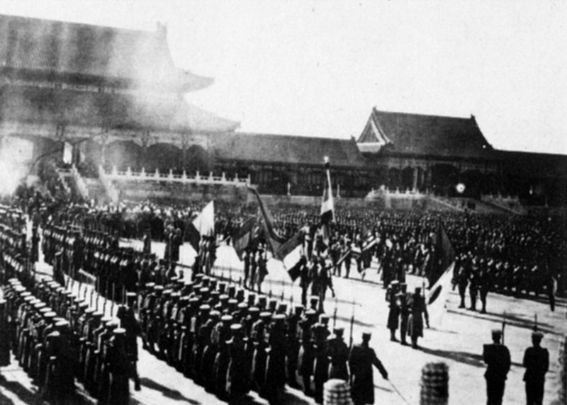
U.S Intervenes in the Boxer Rebellion
After rebellion European powers mistreated rebels, ordered Chinese government to pay for damages
1911 Chinese nationalists overthrow emperor

Slide 5
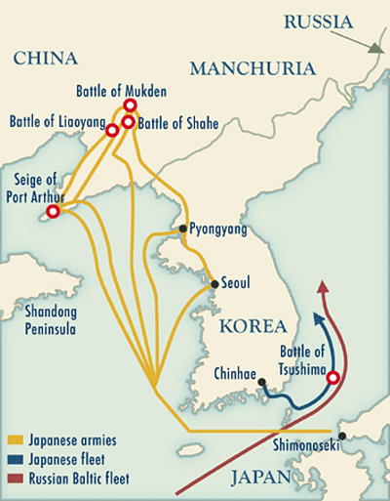
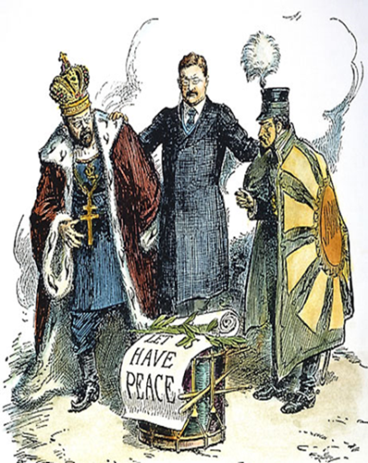
Russo-Japanese War
Japan wanted to extend their influence, did not approve of Europeans actions
Did not like Russian troops in Manchuria
1904 attack Russian fleet, fought Russian troops
Beginning of Russo- Japanese War
U.S. wanted to keep Japan from becoming too powerful
Roosevelt wanted to keep balance of power between countries called peace conference Portsmouth, New Hampshire (1905)
Roosevelt won Nobel Peace Prize for his efforts

Slide 6
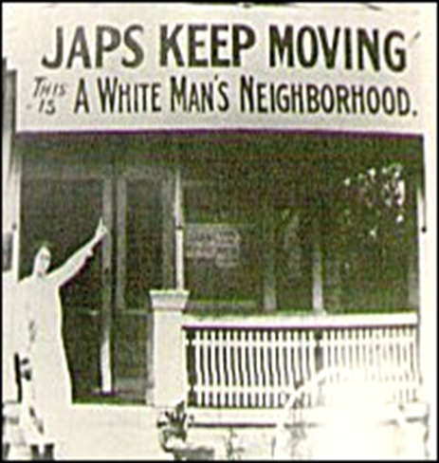
Tensions with Japan
Because of war many Japanese immigrants came to California
Many Californians were upset at “yellow peril”
1906 San Francisco school board ordered segregation of schools to make room for white students
Incident caused international crisis, inflamed by press
1908- Roosevelt forces “Gentlemen's’ Agreement” with Japan
Japanese agree to deny passports to laborers entering the U.S.
Japan recognized the U.S. right to exclude Japanese
The U.S. government got the school board of San Francisco to rescind their order to segregate Asians in separate schools
1908- Root-Takaharia agreement both powers respect the others right to open door in China

Slide 7
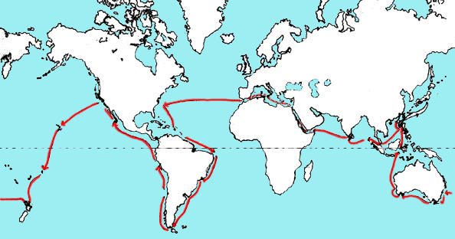
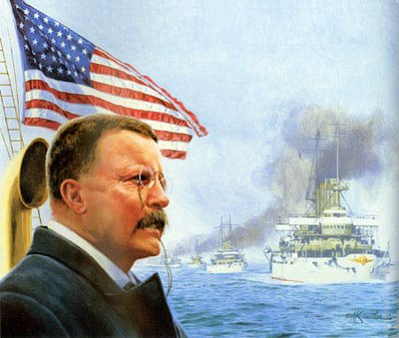
The Great White Fleet
Roosevelt displayed American military power
U.S. Navy went on worldwide tour “Great White Fleet” 1907-1909

Slide 8
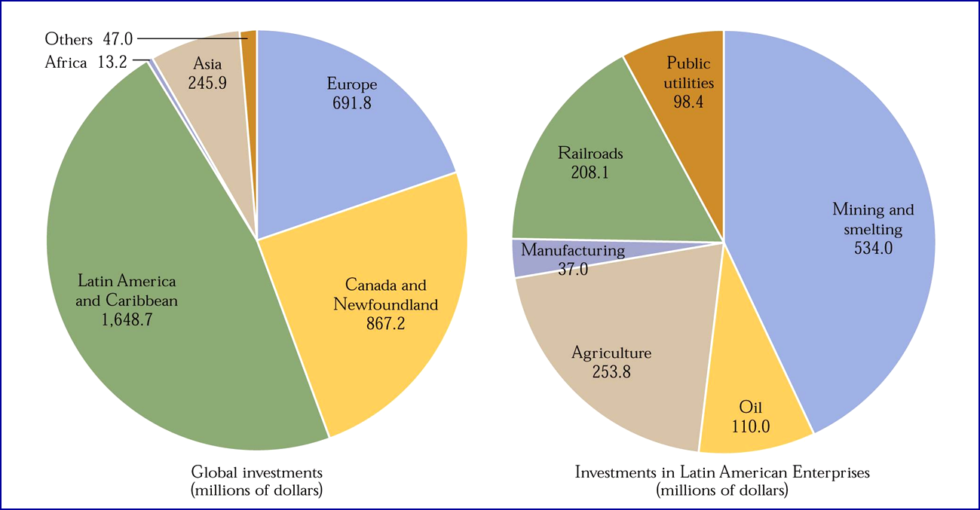
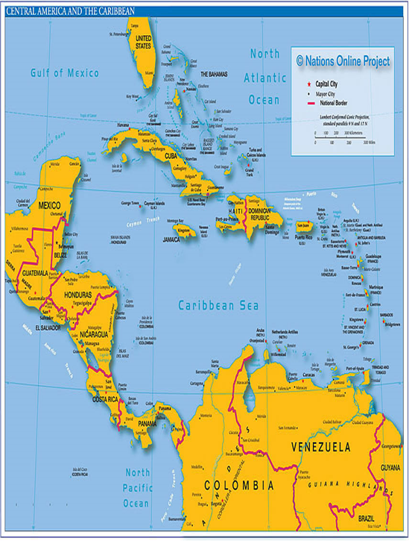
U.S. investment in Latin America

Slide 9
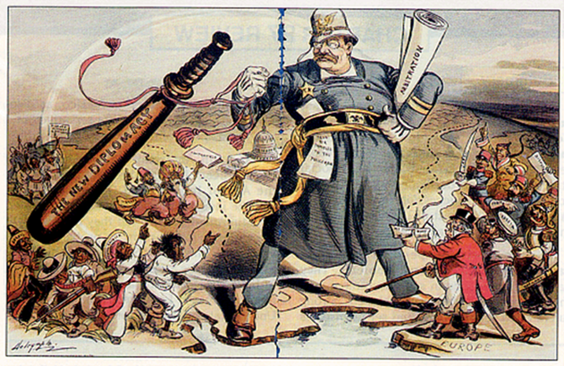
United States in Latin America
U.S. saw Latin America as our sphere of influence
U.S policy towards Latin America
Needed a strong military
U.S. saw treatment towards other countries as moral obligation
Elite and Industry needed to accept challenge of international leadership

Slide 10
U.S. Policy in Puerto Rico and Cuba
After Spanish- American War question of what to do with Cuba, Puerto Rico
Puerto Rico
1900 Foraker Act established civil government
U.S would appoint governor and part of legislature
Puerto Ricans not citizens
Insular Cases Supreme Court said Puerto Ricans not U.S. citizens, but U.S. could collect taxes
1917 Jones Act granted more citizenship rights, self government
Cuba
1902 U.S. army leaves Cuba
Platt Amendment kept Cuba in U.S. sphere of influence
Could not enter into treaty without U.S. approval, had to lease naval stations to U.S., right to intervene in Cuban affairs
Platt Amendment part of Cuban constitution

Slide 11
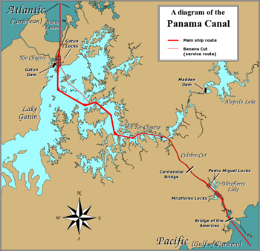
Panama Canal
Late 1800’s French company started building canal
1903 U.S. purchased French claim $40 m
Needed consent of Columbian government to build canal, U.S. did not want to pay their price
U.S. secretly supported independence movement in Panama, sent warships to region
Panama granted independence and gives U.S. control over canal zone

Slide 12
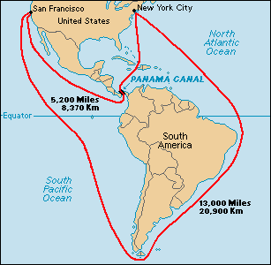
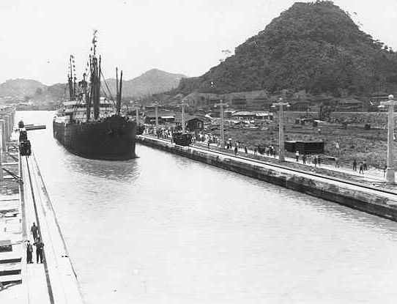
Panama Canal
35,000 workers used to build canal-5,000 died
Opened in 1914
Cut 8,000 miles from ocean trip around North and South America

Slide 13
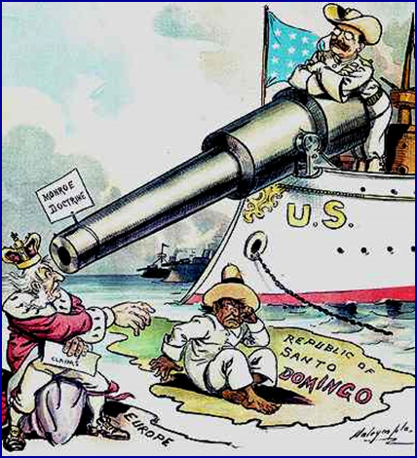
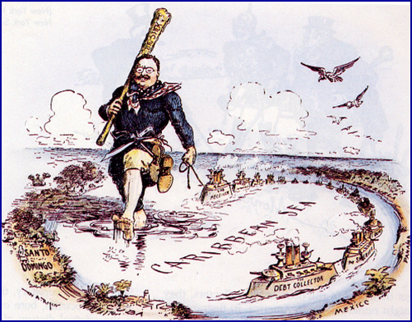
Roosevelt Corollary
Latin American countries could not pay debts to European countries
1904 Roosevelt issues Roosevelt Corollary (to the Monroe Doctrine)
U.S would assume police power over countries in Latin America in cases of “chronic wrongdoing”, instead of European powers
Reasserted Monroe Doctrine keeping Western Hemisphere free of European intervention
Turned Caribbean into “Yankee Lake”
Latin American countries thought it was a way to control region through shield of protection, affected relations for decades

Slide 14
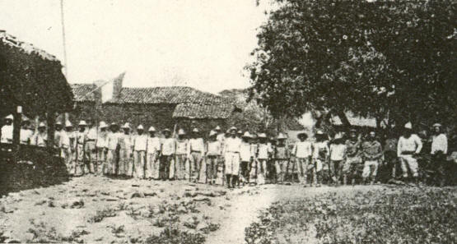
Latin Americans Resist U.S.
Resented America’s role, could take care of themselves
Nicaraguan leader Augusto Sandino fought guerilla war against Marines until 1920’s

Slide 15
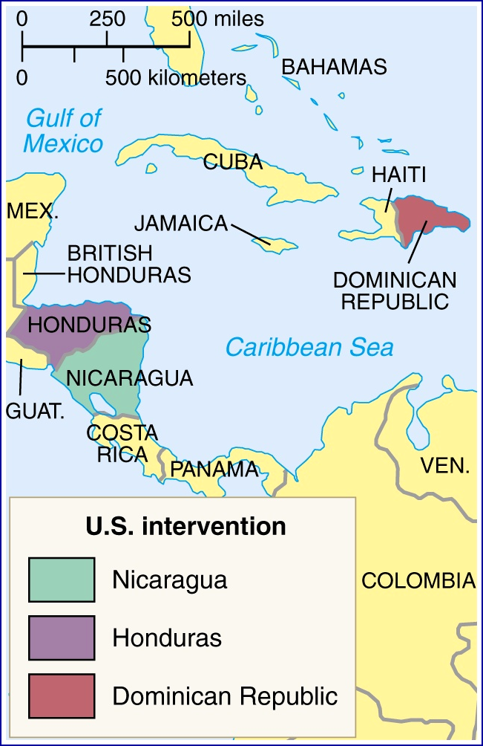
Taft and “Dollar Diplomacy”
Foreign policy was to
maintain “open door policy in Asia,
expand American trade
keep stability in Latin America
Substitute “dollars for bullets”
Increase American investment in Latin America
Provide money for Latin American governments

Slide 16
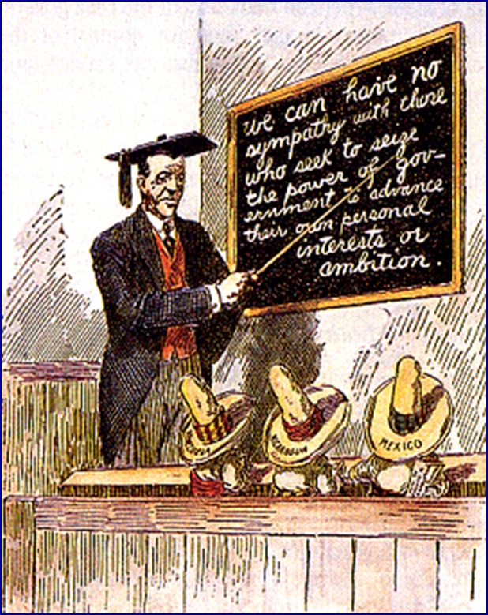
Wilson and Moral Diplomacy
1912 Woodrow Wilson, president, change course of foreign policy
The U. S. should be the conscience of the world.
Spread democracy.
Promote peace.
Condemn colonialism
Called “moral diplomacy”
Did use U.S. military in Latin America

Slide 17
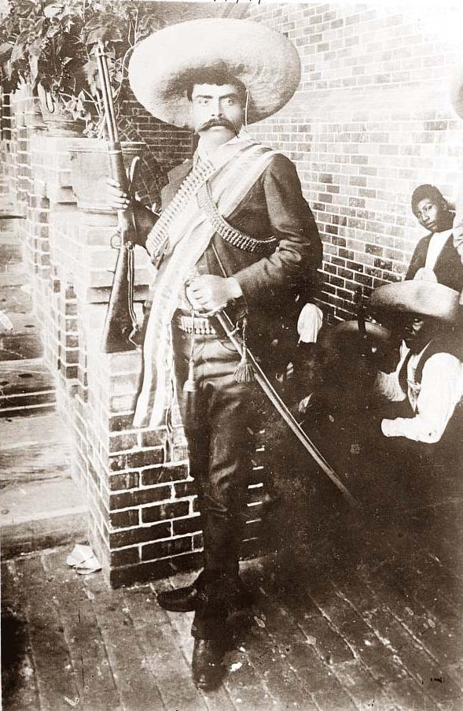
Revolution in Mexico
Mexico wide gap between wealthy and poor, most were poor
Late 1800’s American investment in Mexico expanded
1910 revolution in Mexico
1913 military dictator assumed power (General Huerta)
Wilson did not recognize government
Favored Carranza, sent U.S. Marines and warships to Veracruz, Mexico

Slide 18
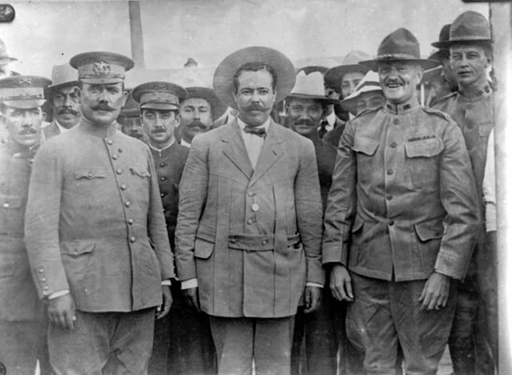
Wilson Sends Troops to Mexico
American sailors arrested in Mexico, excuse needed to occupy Veracruz
All sides in Mexico resented Americans, caused downfall of Huerta, Carranza new president
Period of revolution saw rise of bandit gangs across Mexico

Slide 19
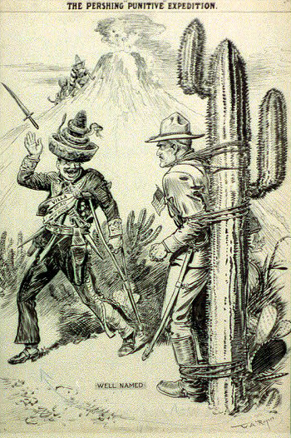
Wilson Sends U.S. Troops to Mexico
“Pancho” Villa attacked Americans
1916- Wilson sent 11,000 troops under Gen. John J. Pershing to find Villa
1917- return to U.S. because of WW I
Mexico incident proving ground for new weapons used in WWI
World War I test of new American global strength

