Slide 1
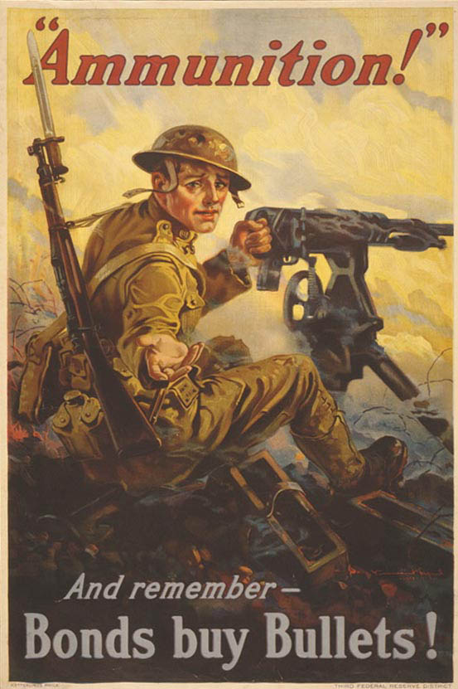
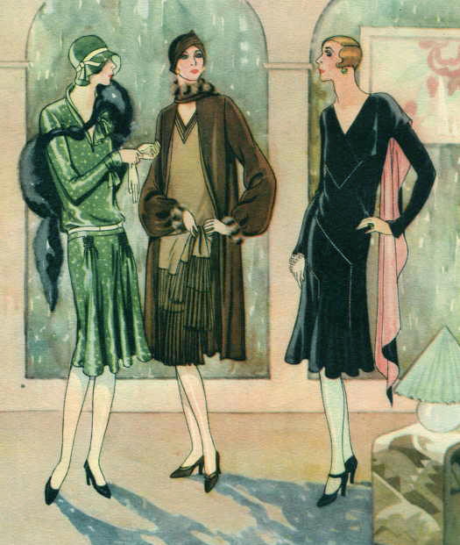
World War One and the 1920’s Chapters 30-32
1917- 1929

Slide 2
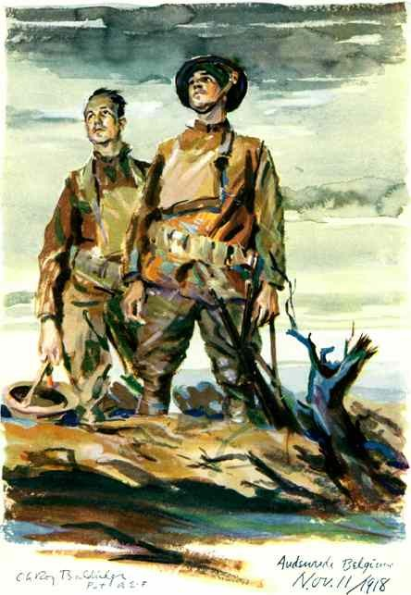
The War to End War
Chapter 30

Slide 3
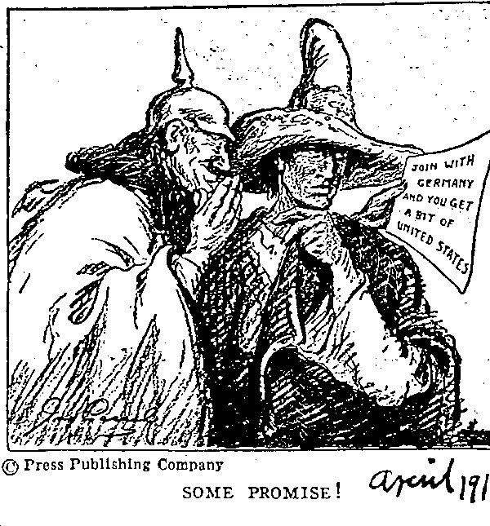
I. War by Act of Germany
Wilson won re-election in 1916 by keeping America out of the war
Three groups
Isolationists- Not intervene in European affairs
Internationalists- Work for peace, not enter war
Interventionists- Enter war on side of Allies, protect interests
Wilson supported internationalists
1917 three events led U.S. to war
Unrestricted submarine warfare by Germans
Zimmerman note intercepted- German proposal to Mexico to be allies and after German victory territory lost in Mexican-American War (1848) would be returned
Russian Revolution toppled tsar, America could now focus on war for democracy not despotism
April 2, 1917 U.S. declares war on Germany

Slide 4
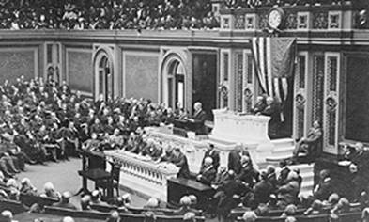
II. Wilsonian Idealism Enthroned
War shattered American tradition of isolationism
Wilson had to frame war as “making world safe for democracy’, more glorified aim
War not for territorial conquest or riches, but to shape international order
Modern world could not afford destructive wars
Presidents appeal fired up Americans to support war
Wilson recognized as moral leader of war
Jan. 1918 Fourteen Points Address
Abolish secret treaties
Freedom of the seas
Removal of economic barriers
Reduction of Armaments
Get rid of colonialism
Organize a system of collective security
Idea was to delegitimize colonial powers, open world to political and economic freedom, not popular with many European powers

Slide 5
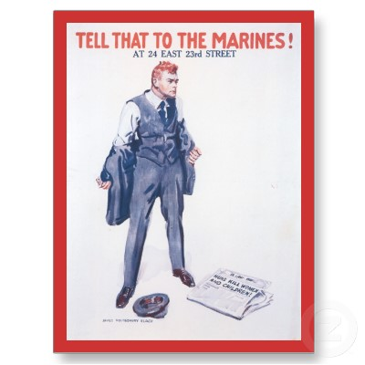
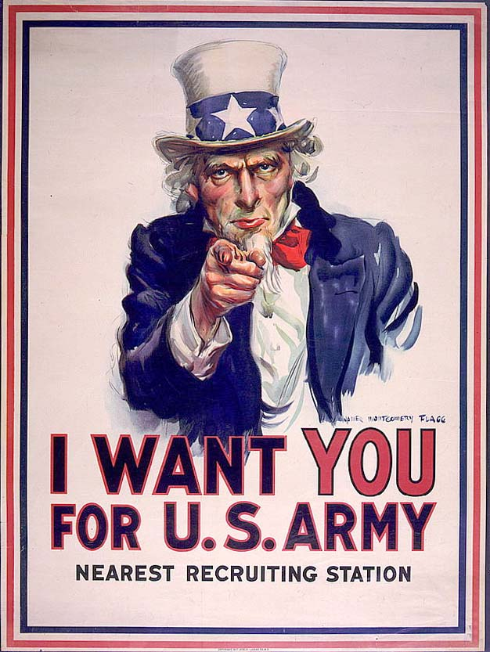
III. Gaining American Support and Enforcing Loyalty
During war government assumed new powers
Changed relationship with federal government
War relied on voluntary compliance more than formal laws
Build military Congress passes Selective Service Act (1917) drafts men for war
4.8 million serve in WWI
1917- Committee for Public Information (CPI)- educate public on causes and nature of war
Advertising to “sell America” on war
Not all Americans supported war
Government took away individual liberties to quiet dissent
Resistance to the draft
Seen as illegal intrusion into private lives, did not cooperate with draft boards
Conscientious objectors- moral or religious reasons forbid fighting in wars

Slide 6
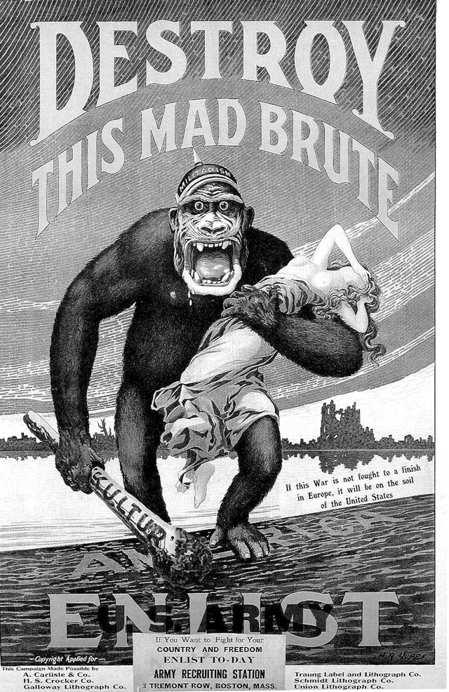
III. Gaining American Support and Enforcing Loyalty
CPI stifled free expression
1917- Espionage Act- penalties for obstructing war effort (print, mail, resisting draft)
1918- Sedition Act- unlawful to speak out about government. Used against socialists, political radicals and pacifists
Supreme Court ruled acts constitutional (Schenck v. U.S. 1919) During wartime freedom of speech does not apply (if it presents a clear and present danger)
Germany seen as primary foe against U.S.
Harassment, violence against German Americans
Stopped teaching German in schools, playing German composers music

Slide 7
IV. The Nations Factories go to War
Wilson organized an effort to supply American in the war effort
Many Americans had fear of government control and balked at the government effort
Overall cooperation, not competition marked industrial effort
To combat this Wilson formed the War Industries Board (1918) to oversee industrial production
American workers threatened by “work or fight” to combat unemployment
Labor was given a boost by war, wages rose and work days standardized to eight hours, still no government guarantee to organize into unions
War effort supported by AF of L but not by more radical groups (IWW) who committed acts of sabotage
Wartime prices rose and this negated most wage gains
1919 steel strike was met with resistance by factory owners who brought in scabs and setback the union movement

Slide 8
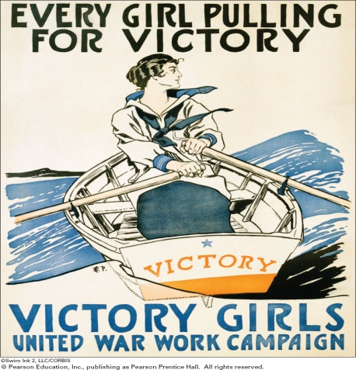
V. Changes for Women and African Americans
Women
Men left workforce , labor shortage filled by women
Took jobs previously open to men
Women served Red Cross, Army Corps of Nurses in Europe during war
Many progressive era feminists were pacifists
Efforts and sacrifices during war led Wilson to support passage of 19th Amendment
Economic gains proved fleeting, many women gave up wartime jobs

Slide 9
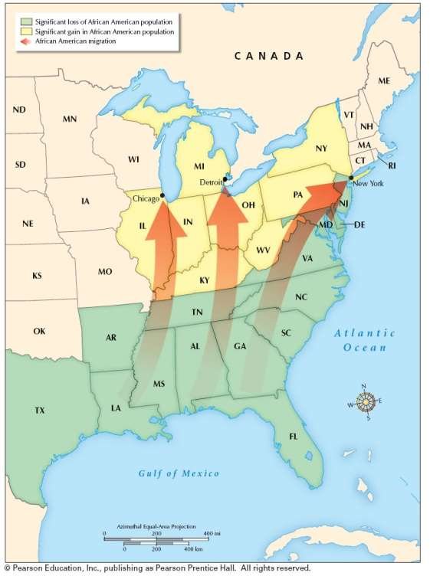
V. Changes for Women and African Americans
African Americans
Many served in military, in segregated units and mostly behind the lines
Many went north during the war for employment
Caused racial strife in some cities (Chicago riots 1917)
Movement from rural South to Chicago, Detroit, industrial Northeast
Escape racism, poverty of life in south, promise economic advancement
Called “Great Migration” (1.2 million moved 1910-1920)

Slide 10
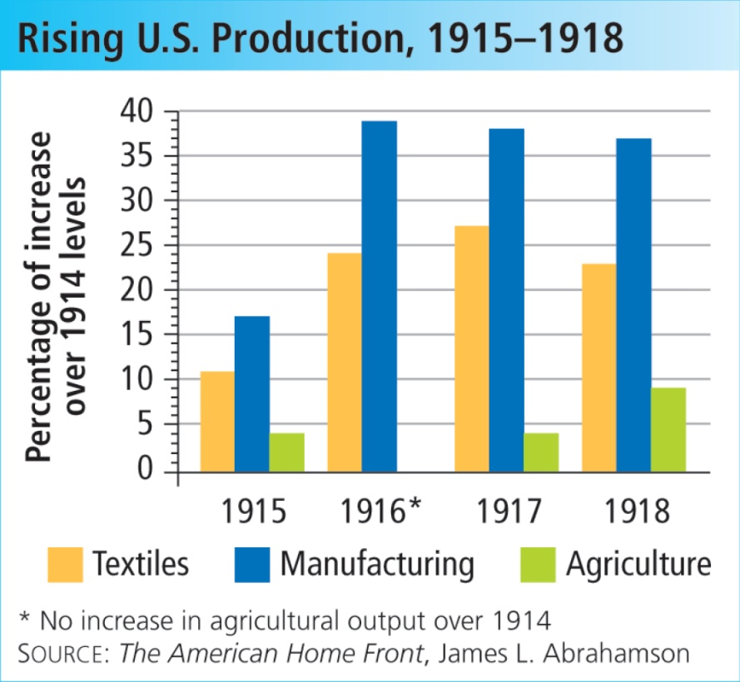
VI. Forging a War Economy
America had to feed themselves and allies, went into it haphazardly
Herbert Hoover was put in charge of food production effort, effort relied on voluntary cooperation rather than legal means
Used propaganda campaign to save food for export, promoted “victory gardens”
Spirit of self denial led to decline in consumption of alcohol and eventually the passage of the 19th Amendment
Food production and export rose during war
Other wartime administrations copied Hoover’s lead
Treasury Department held “liberty bond” drives to raise money for the war effort
Involuntary increase in taxes raised the rest of the money to fund the war
Government exercised power of railroads and nationalized them during the war

Slide 11
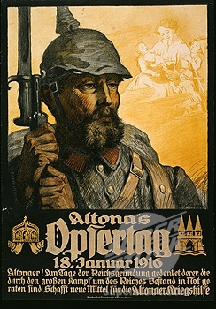
VII. American Entry into the War
At the beginning of the war, most Americans thought America would contribute naval power and supplies to Allies
1917- Central powers gained an edge on Western Front
March 1917 Czar of Russia overthrown in revolution
November 1917 Vladimir Lenin and socialists take over Russian government, sign treaty with Germany and leave war
Spring 1918 Germans begin new offensive on Western Front
Early 1917 Allies ask for manpower and draft was instituted, believed the US could not raise enough men to fight in time
Draft was more effective with fewer loopholes than during Civil War draft
By early 1918 the first poorly trained American soldiers began to arrive in Europe

Slide 12
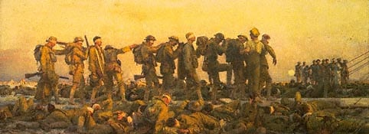
Technology, Trench Warfare and a Stalemate
War unlike others
Trench warfare- built trenches, attacked, counter- attacked each other across “no-mans land”
High death toll- machine guns, artillery, tanks, poison gas produced massive causalities
Effective defensive weapons led to stalemate- no side could gain advantage

Slide 13
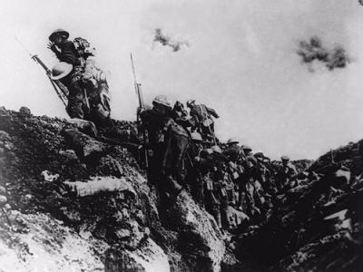
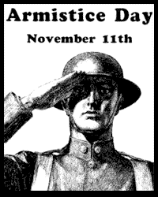
VII. American Entry into the War
Early 1918 American troops arrive in large numbers
Commanded by John J. Pershing
German offensives became less effective, troops became exhausted
American troops gave Allies military advantage
Fall 1918 German troops were running out of food, many mutinied, deserted, refused to fight
Germans surrendered Nov. 11, 1918

Slide 14
VIII. End of the War
The main US contribution to the war was food, munitions, credit, oil and manpower
Prospect of endless US troops and material contributed to the end of the war
Wilson wanted the peace based on the Fourteen Points, he was seen at the end of the war as the moral leader of the world
By the time Wilson went to the peace conference he was a diminished leader in the US due to Republican victories in the Congressional elections of 1918
Going to Paris personally seemed to many like grandstanding and Wilson made a political mistake by not including a single Republican in the peace delegation

Slide 15
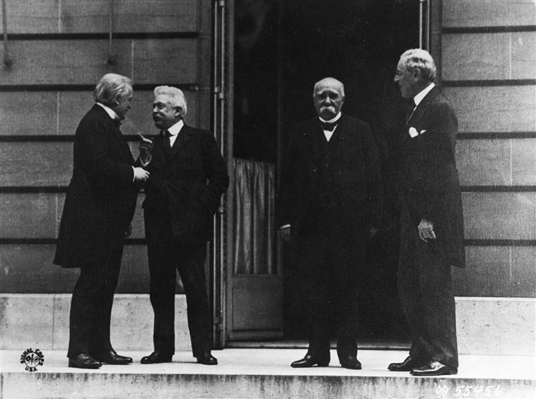
VIII. End of the War
European leaders kept the new hero Wilson at arms length, they felt that he would disrupt the status quo
Big Four of Paris Peace Conference Wilson, David Lloyd George (Great Britain), Georges Clemenceau (France), Vittorio Orlando (Italy)
Russia stayed out, Lenin thought the war was an imperialist land grab
Wilson’s main goal was to establish the League of Nations controlled by the great powers
Wilson did not want the victors to be vengeful to their former enemies, he wanted “peace without victory”
Promoted openness, independence
Move to end colonialism
National self- determination (right of people to choose their own form of government)
Disarmament
Asked for League of Nations to promote peaceful cooperation among nations, collective security
The European countries had different ideas

Slide 16
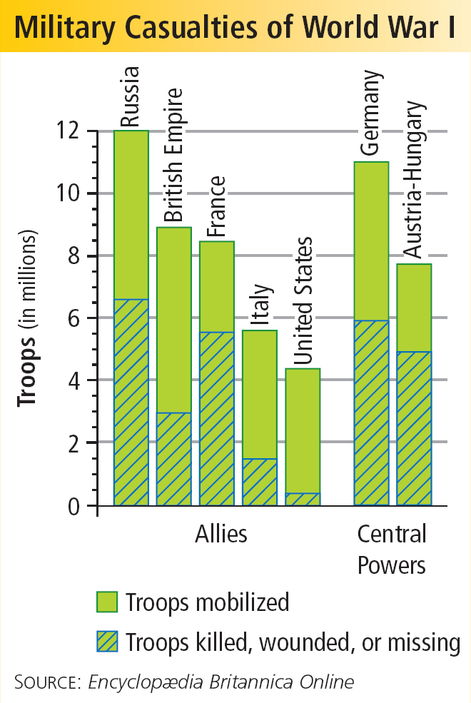
VIII. End of the War
European allies blamed Germany for starting war, wanted them punished
Suffered more than Americans
Germany had to pay reparations (payment for war damages)
Rejected ideas to end colonialism, disarm Europe, free trade
Allied powers were torn by conflicting aims and the peace was a fractured one
French claims in the Ruhr region caused tension with Germany
France signed a pact with Great Britain and US to provide for aid in case of another German invasion
New nations emerged in Europe, liberated millions
Austrian, German people found themselves as part of new countries
Breakup of Ottoman Empire clustered different ethnic groups together
Middle East broken up by European powers, not allowed to practice self- determination
Wilson did get League of Nations in a compromise with the European leaders

Slide 17
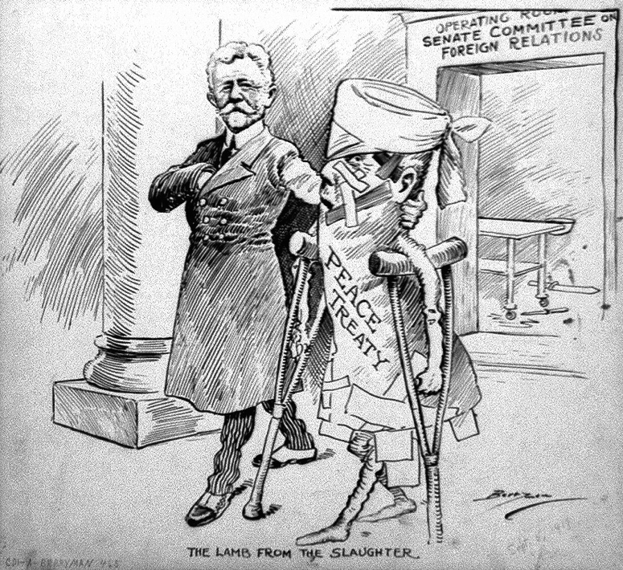
IX. Selling the Treaty to the US
Many Americans thought US was entering into “tangling alliances” of European affairs, the League of Nations was also seen as a “super state” and was opposed by the isolationists
Some thought treaty was not harsh enough
German and Italian Americans thought treaty was too harsh
Some thought treaty gave British too much influence
Republicans and isolationists in Senate (led by Henry Cabot Lodge) used delay tactics to keep treaty from being passed
Eventually apathy and confusion crept in to the treaty debate
Wilson tried the direct appeal method to get support for the treaty, during his tour he had a stroke and could not actively campaign for the Treaty of Versailles
Lodge took control of the proceedings and would not pass the treaty if it included the League of Nations
Wilson urged Democrats to reject the treaty Lodge proposed, it was defeated
The Treaty of Versailles was also defeated by traditions of isolationism, disillusionment with the war and partisanship

Slide 18
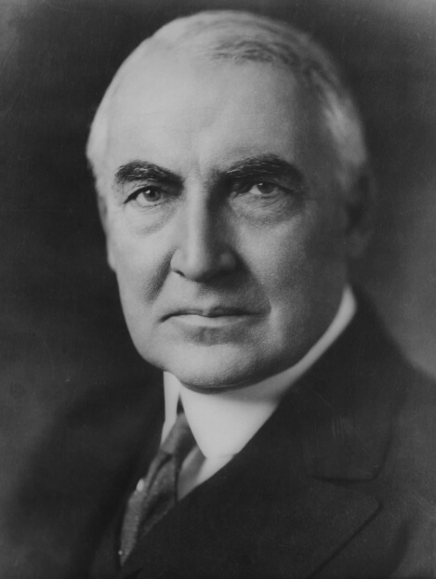
X. A Return to “Normalcy”
Public desire for change from the progressive politics and high minded ideals of Wilson
Elected Republican Warren G. Harding of Ohio as president
Opposite of Wilson, back slapper and dull minded
With the election of Harding the idea of the League of Nations was dead
America emerged from the war a changed country nationally and internationally
1920 America world economic giant, largest creditor nation
Compared to Europe, U.S. came out of war strong and prosperous

